Slide 1
Chapter 2 Operating System Overview
Operating Systems: Internals and Design Principles
Seventh Edition
By William Stallings
Notes:
“Operating Systems: Internal and Design Principles”, 7/e, by William Stallings, Chapter 2 “Operating System Overview”.

Slide 2
Operating Systems: Internals and Design Principles
Operating systems are those programs that interface the machine with
the applications programs. The main function of these systems is to
dynamically allocate the shared system resources to the executing
programs. As such, research in this area is clearly concerned with
the management and scheduling of memory, processes, and other
devices. But the interface with adjacent levels continues to shift with
time. Functions that were originally part of the operating system have
migrated to the hardware. On the other side, programmed functions
extraneous to the problems being solved by the application programs
are included in the operating system.
—WHAT CAN BE AUTOMATED?: THE COMPUTER SCIENCE AND
ENGINEERING RESEARCH STUDY,
MIT Press, 1980
Notes:
We begin our study of operating systems (OSs) with a brief history. This history is
itself interesting and also serves the purpose of providing an overview of OS principles.
The first section examines the objectives and functions of operating systems.
Then we look at how operating systems have evolved from primitive batch systems
to sophisticated multitasking, multiuser systems. The remainder of the chapter looks
at the history and general characteristics of the two operating systems that serve as
examples throughout this book. All of the material in this chapter is covered in
greater depth later in the book.

Slide 3
Operating System
A program that controls the execution of application programs
An interface between applications and hardware
Main objectives of an OS:
Convenience
Efficiency
Ability to evolve
Notes:
An OS is a program that controls the execution of application programs and acts as
an interface between applications and the computer hardware. It can be thought of
as having three objectives:
• Convenience: An OS makes a computer more convenient to use.
• Efficiency: An OS allows the computer system resources to be used in an efficient
manner.
• Ability to evolve: An OS should be constructed in such a way as to permit the
effective development, testing, and introduction of new system functions without
interfering with service.

Slide 4
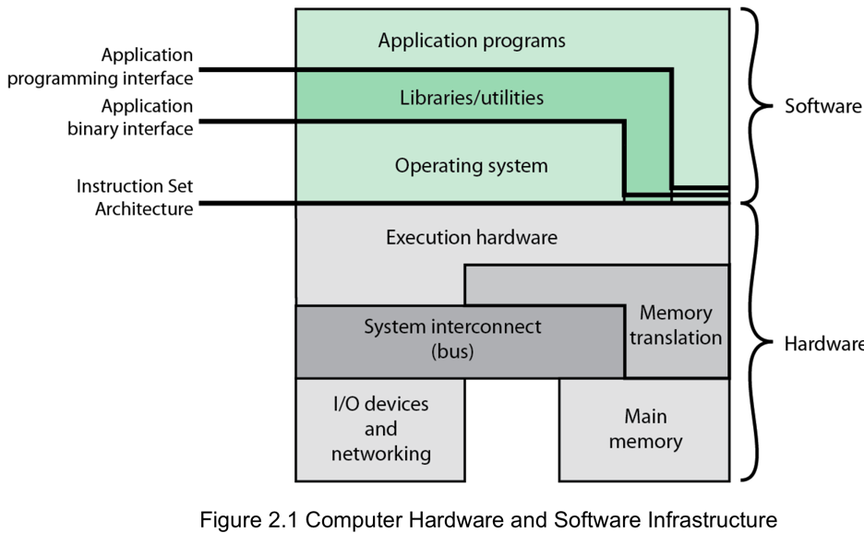
Computer Hardware and Software Infrastructure
Notes:
The Operating System as a User/Computer Interface
The hardware and software used in providing applications to a user can be viewed
in a layered or hierarchical fashion, as depicted in Figure 2.1 . The user of those
applications, the end user, generally is not concerned with the details of computer
hardware. Thus, the end user views a computer system in terms of a set of applications.
An application can be expressed in a programming language and is developed
by an application programmer. If one were to develop an application program as a
set of machine instructions that is completely responsible for controlling the computer
hardware, one would be faced with an overwhelmingly complex undertaking.
To ease this chore, a set of system programs is provided. Some of these programs
are referred to as utilities, or library programs. These implement frequently used
functions that assist in program creation, the management of files, and the control of
I/O devices. A programmer will make use of these facilities in developing an application,
and the application, while it is running, will invoke the utilities to perform
certain functions. The most important collection of system programs comprises the
OS. The OS masks the details of the hardware from the programmer and provides
the programmer with a convenient interface for using the system. It acts as mediator,
making it easier for the programmer and for application programs to access and
use those facilities and services.

Slide 5

Operating System Services
Program development
Program execution
Access I/O devices
Controlled access to files
System access
Error detection and response
Accounting
Notes:
Briefly, the OS typically provides services in the following areas:
• Program development: The OS provides a variety of facilities and services,
such as editors and debuggers, to assist the programmer in creating programs.
Typically, these services are in the form of utility programs that, while not
strictly part of the core of the OS, are supplied with the OS and are referred to
as application program development tools.
• Program execution: A number of steps need to be performed to execute a
program. Instructions and data must be loaded into main memory, I/O devices
and files must be initialized, and other resources must be prepared. The OS
handles these scheduling duties for the user.
• Access to I/O devices: Each I/O device requires its own peculiar set of instructions
or control signals for operation. The OS provides a uniform interface
that hides these details so that programmers can access such devices using simple
reads and writes.
• Controlled access to files: For file access, the OS must reflect a detailed understanding
of not only the nature of the I/O device (disk drive, tape drive) but
also the structure of the data contained in the files on the storage medium.
In the case of a system with multiple users, the OS may provide protection
mechanisms to control access to the files.
• System access: For shared or public systems, the OS controls access to the
system as a whole and to specific system resources. The access function must
provide protection of resources and data from unauthorized users and must
resolve conflicts for resource contention.
• Error detection and response: A variety of errors can occur while a computer
system is running. These include internal and external hardware errors, such
as a memory error, or a device failure or malfunction; and various software
errors, such as division by zero, attempt to access forbidden memory location,
and inability of the OS to grant the request of an application. In each case,
the OS must provide a response that clears the error condition with the least
impact on running applications. The response may range from ending the program
that caused the error, to retrying the operation, to simply reporting the
error to the application.
• Accounting: A good OS will collect usage statistics for various resources and
monitor performance parameters such as response time. On any system, this
information is useful in anticipating the need for future enhancements and in
tuning the system to improve performance. On a multiuser system, the information
can be used for billing purposes.

Slide 6
Key Interfaces
Instruction set architecture (ISA)
Application binary interface (ABI)
Application programming interface (API)
Notes:
Figure 2.1 also indicates three key interfaces in a typical computer system:
• Instruction set architecture (ISA) : The ISA defines the repertoire of machine
language instructions that a computer can follow. This interface is the boundary
between hardware and software. Note that both application programs
and utilities may access the ISA directly. For these programs, a subset of the
instruction repertoire is available (user ISA). The OS has access to additional
machine language instructions that deal with managing system resources
(system ISA).
• Application binary interface (ABI) : The ABI defines a standard for binary
portability across programs. The ABI defines the system call interface to
the operating system and the hardware resources and services available in a
system through the user ISA.
• Application programming interface (API) : The API gives a program access
to the hardware resources and services available in a system through the user
ISA supplemented with high-level language (HLL) library calls. Any system
calls are usually performed through libraries. Using an API enables application
software to be ported easily, through recompilation, to other systems that
support the same API.

Slide 7
The Role of an OS
A computer is a set of resources for the movement, storage, and processing of data
The OS is responsible for managing these resources
Notes:
A computer is a set of resources for the movement, storage, and processing of data
and for the control of these functions. The OS is responsible for managing these
resources.

Slide 8

Operating System as Software
Functions in the same way as ordinary computer software
Program, or suite of programs, executed by the processor
Frequently relinquishes control and must depend on the processor to allow it to regain control
Notes:
The OS, as a control mechanism is unusual in two respects:
• The OS functions in the same way as ordinary computer software; that is, it is
a program or suite of programs executed by the processor.
• The OS frequently relinquishes control and must depend on the processor to
allow it to regain control.
Like other computer programs, the OS provides instructions for the processor.
The key difference is in the intent of the program. The OS directs the processor
in the use of the other system resources and in the timing of its execution of other
programs. But in order for the processor to do any of these things, it must cease
executing the OS program and execute other programs. Thus, the OS relinquishes
control for the processor to do some “useful” work and then resumes control long
enough to prepare the processor to do the next piece of work. The mechanisms
involved in all this should become clear as the chapter proceeds.

Slide 9
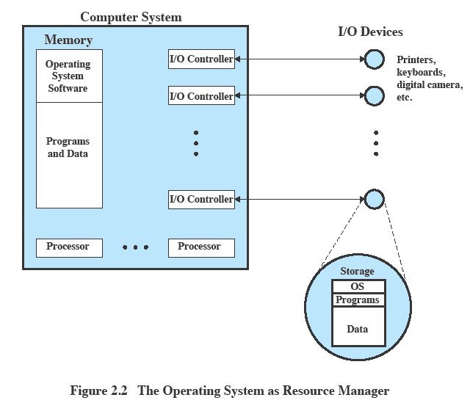
Operating System as Resource Manager
Notes:
Figure 2.2 suggests the main resources that are managed by the OS. A portion
of the OS is in main memory. This includes the kernel , or nucleus , which contains
the most frequently used functions in the OS and, at a given time, other portions
of the OS currently in use. The remainder of main memory contains user programs
and data. The memory management hardware in the processor and the OS jointly
control the allocation of main memory, as we shall see. The OS decides when an I/O
device can be used by a program in execution and controls access to and use of files.
The processor itself is a resource, and the OS must determine how much processor
time is to be devoted to the execution of a particular user program. In the case of a
multiple-processor system, this decision must span all of the processors.

Slide 10
Evolution of Operating Systems
A major OS will evolve over time for a number of reasons:
Hardware upgrades
New types of hardware
New services
Fixes
Notes:
A major OS will evolve over time for a number of reasons:
• Hardware upgrades plus new types of hardware: For example, early versions
of UNIX and the Macintosh OS did not employ a paging mechanism because
they were run on processors without paging hardware. 1 Subsequent versions
of these operating systems were modified to exploit paging capabilities. Also,
the use of graphics terminals and page-mode terminals instead of line-at-a time
scroll mode terminals affects OS design. For example, a graphics terminal
typically allows the user to view several applications at the same time through
“windows” on the screen. This requires more sophisticated support in the OS.
• New services: In response to user demand or in response to the needs of system
managers, the OS expands to offer new services. For example, if it is found
to be difficult to maintain good performance for users with existing tools, new
measurement and control tools may be added to the OS.
• Fixes: Any OS has faults. These are discovered over the course of time and
fixes are made. Of course, the fix may introduce new faults.
The need to change an OS regularly places certain requirements on its design.
An obvious statement is that the system should be modular in construction, with
clearly defined interfaces between the modules, and that it should be well documented.
For large programs, such as the typical contemporary OS, what might be
referred to as straightforward modularization is inadequate [DENN80a]. That is,
much more must be done than simply partitioning a program into modules. We
return to this topic later in this chapter.

Slide 11
Evolution of Operating Systems
Stages include:
Serial Processing
Simple Batch Systems
Multiprogrammed Batch Systems
Time Sharing Systems
Notes:
In attempting to understand the key requirements for an OS and the significance of the major features of a contemporary OS, it is useful to consider how operating systems have evolved over the years.

Slide 12
Serial Processing
Earliest Computers:
Problems:
Scheduling:
most installations used a hardcopy sign-up sheet to reserve computer time
time allocations could run short or long, resulting in wasted computer time
Setup time
a considerable amount of time was spent just on setting up the program to run
No operating system
programmers interacted directly with the computer hardware
Computers ran from a console with display lights, toggle switches, some form of input device, and a printer
Users have access to the computer in “series”
Notes:
With the earliest computers, from the late 1940s to the mid-1950s, the programmer
interacted directly with the computer hardware; there was no OS. These computers
were run from a console consisting of display lights, toggle switches, some form of
input device, and a printer. Programs in machine code were loaded via the input
device (e.g., a card reader). If an error halted the program, the error condition was
indicated by the lights. If the program proceeded to a normal completion, the output
appeared on the printer.
These early systems presented two main problems:
• Scheduling : Most installations used a hardcopy sign-up sheet to reserve computer
time. Typically, a user could sign up for a block of time in multiples of a
half hour or so. A user might sign up for an hour and finish in 45 minutes; this
would result in wasted computer processing time. On the other hand, the user
might run into problems, not finish in the allotted time, and be forced to stop
before resolving the problem.
• Setup time: A single program, called a job , could involve loading the compiler
plus the high-level language program (source program) into memory,
saving the compiled program (object program) and then loading and linking
together the object program and common functions. Each of these steps could
involve mounting or dismounting tapes or setting up card decks. If an error
occurred, the hapless user typically had to go back to the beginning of the
setup sequence. Thus, a considerable amount of time was spent just in setting
up the program to run.
This mode of operation could be termed serial processing , reflecting the fact
that users have access to the computer in series. Over time, various system software
tools were developed to attempt to make serial processing more efficient. These
include libraries of common functions, linkers, loaders, debuggers, and I/O driver
routines that were available as common software for all users.

Slide 13
Simple Batch Systems
Early computers were very expensive
important to maximize processor utilization
Monitor
user no longer has direct access to processor
job is submitted to computer operator who batches them together and places them on an input device
program branches back to the monitor when finished
Notes:
Early computers were very expensive, and therefore it was important to maximize
processor utilization. The wasted time due to scheduling and setup time was
unacceptable.
To improve utilization, the concept of a batch OS was developed. It appears
that the first batch OS (and the first OS of any kind) was developed in the mid-1950s
by General Motors for use on an IBM 701 [WEIZ81]. The concept was subsequently
refined and implemented on the IBM 704 by a number of IBM customers. By the
early 1960s, a number of vendors had developed batch operating systems for their
computer systems. IBSYS, the IBM OS for the 7090/7094 computers, is particularly
notable because of its widespread influence on other systems.
The central idea behind the simple batch-processing scheme is the use of a
piece of software known as the monitor . With this type of OS, the user no longer has
direct access to the processor. Instead, the user submits the job on cards or tape to a
computer operator, who batches the jobs together sequentially and places the entire
batch on an input device, for use by the monitor. Each program is constructed to
branch back to the monitor when it completes processing, at which point the monitor
automatically begins loading the next program.

Slide 14
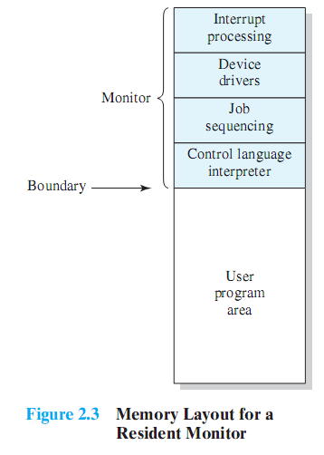
Monitor Point of View
Monitor controls the sequence of events
Resident Monitor is software always in memory
Monitor reads in job and gives control
Job returns control to monitor
Notes:
Monitor point of view: The monitor controls the sequence of events. For this
to be so, much of the monitor must always be in main memory and available
for execution ( Figure 2.3 ). That portion is referred to as the resident monitor .
The rest of the monitor consists of utilities and common functions that are
loaded as subroutines to the user program at the beginning of any job that
requires them. The monitor reads in jobs one at a time from the input device
(typically a card reader or magnetic tape drive). As it is read in, the current job
is placed in the user program area, and control is passed to this job. When the
job is completed, it returns control to the monitor, which immediately reads
in the next job. The results of each job are sent to an output device, such as a
printer, for delivery to the user.

Slide 15
Processor Point of View
Processor executes instruction from the memory containing the monitor
Executes the instructions in the user program until it encounters an ending or error condition
“control is passed to a job” means processor is fetching and executing instructions in a user program
“control is returned to the monitor” means that the processor is fetching and executing instructions from the monitor program
Notes:
Processor point of view: At a certain point, the processor is executing instructions
from the portion of main memory containing the monitor. These
instructions cause the next job to be read into another portion of main
memory. Once a job has been read in, the processor will encounter a branch
instruction in the monitor that instructs the processor to continue execution
at the start of the user program. The processor will then execute the instructions
in the user program until it encounters an ending or error condition.
Either event causes the processor to fetch its next instruction from the monitor
program. Thus the phrase “control is passed to a job” simply means that
the processor is now fetching and executing instructions in a user program,
and “control is returned to the monitor” means that the processor is now
fetching and executing instructions from the monitor program.

Slide 16
Job Control Language (JCL)
Special type of programming language used to provide instructions to the monitor
what compiler to use
what data to use
Notes:
The monitor performs a scheduling function: A batch of jobs is queued up,
and jobs are executed as rapidly as possible, with no intervening idle time. The monitor
improves job setup time as well. With each job, instructions are included in a
primitive form of job control language (JCL) . This is a special type of programming
language used to provide instructions to the monitor. A simple example is that of a
user submitting a program written in the programming language FORTRAN plus
some data to be used by the program. All FORTRAN instructions and data are on a
separate punched card or a separate record on tape. In addition to FORTRAN and
data lines, the job includes job control instructions, which are denoted by the beginning
$.

Slide 17

Desirable Hardware Features
Memory protection for monitor
while the user program is executing, it must not alter the memory area containing the monitor
Timer
prevents a job from monopolizing the system
Privileged instructions
can only be executed by the monitor
Interrupts
gives OS more flexibility in controlling user programs
Notes:
The monitor, or batch OS, is simply a computer program. It relies on the ability
of the processor to fetch instructions from various portions of main memory to
alternately seize and relinquish control. Certain other hardware features are also
desirable:
• Memory protection: While the user program is executing, it must not alter the
memory area containing the monitor. If such an attempt is made, the processor
hardware should detect an error and transfer control to the monitor. The
monitor would then abort the job, print out an error message, and load in the
next job.
• Timer: A timer is used to prevent a single job from monopolizing the system.
The timer is set at the beginning of each job. If the timer expires, the user program
is stopped, and control returns to the monitor.
• Privileged instructions : Certain machine level instructions are designated privileged
and can be executed only by the monitor. If the processor encounters
such an instruction while executing a user program, an error occurs causing
control to be transferred to the monitor. Among the privileged instructions
are I/O instructions, so that the monitor retains control of all I/O devices. This
prevents, for example, a user program from accidentally reading job control
instructions from the next job. If a user program wishes to perform I/O, it must
request that the monitor perform the operation for it.
Interrupts : Early computer models did not have this capability. This feature
gives the OS more flexibility in relinquishing control to and regaining control
from user programs.

Slide 18
Modes of Operation
User Mode
user program executes in user mode
certain areas of memory are protected from user access
certain instructions may not be executed
Kernel Mode
monitor executes in kernel mode
privileged instructions may be executed
protected areas of memory may be accessed
Notes:
Considerations of memory protection and privileged instructions lead to the
concept of modes of operation. A user program executes in a user mode , in which
certain areas of memory are protected from the user’s use and in which certain
instructions may not be executed. The monitor executes in a system mode, or what
has come to be called kernel mode , in which privileged instructions may be executed
and in which protected areas of memory may be accessed.
Of course, an OS can be built without these features. But computer vendors
quickly learned that the results were chaos, and so even relatively primitive batch
operating systems were provided with these hardware features.

Slide 19
Simple Batch System Overhead
Processor time alternates between execution of user programs and execution of the monitor
Sacrifices:
some main memory is now given over to the monitor
some processor time is consumed by the monitor
Despite overhead, the simple batch system improves utilization of the computer
Notes:
With a batch OS, processor time alternates between execution of user programs
and execution of the monitor. There have been two sacrifices: Some main
memory is now given over to the monitor and some processor time is consumed by
the monitor. Both of these are forms of overhead. Despite this overhead, the simple
batch system improves utilization of the computer.

Slide 20
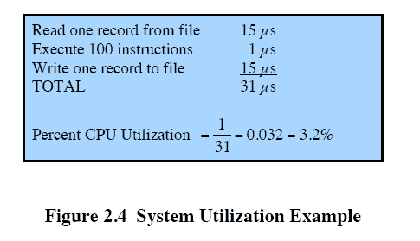
Multiprogrammed Batch Systems
Processor is often idle
even with automatic job sequencing
I/O devices are slow compared to processor
Notes:
Even with the automatic job sequencing provided by a simple batch OS, the processor
is often idle. The problem is that I/O devices are slow compared to the processor.
Figure 2.4 details a representative calculation. The calculation concerns a program
that processes a file of records and performs, on average, 100 machine instructions
per record. In this example, the computer spends over 96% of its time waiting for
I/O devices to finish transferring data to and from the file.

Slide 21

Uniprogramming
The processor spends a certain amount of time executing, until it reaches an I/O instruction; it must then wait until that I/O instruction concludes before proceeding
Notes:
Figure 2.5a illustrates this situation, where we have a single program, referred to as uniprogramming.
The processor spends a certain amount of time executing, until it reaches an I/O instruction.
It must then wait until that I/O instruction concludes before proceeding.

Slide 22
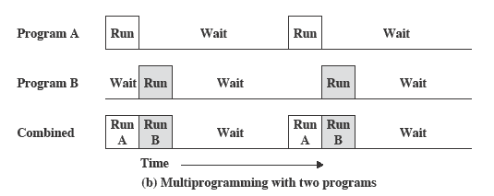
Multiprogramming
There must be enough memory to hold the OS (resident monitor) and one user program
When one job needs to wait for I/O, the processor can switch to the other job, which is likely not waiting for I/O
Notes:
This inefficiency is not necessary. We know that there must be enough
memory to hold the OS (resident monitor) and one user program. Suppose that
there is room for the OS and two user programs. When one job needs to wait for
I/O, the processor can switch to the other job, which is likely not waiting for I/O
( Figure 2.5b ).

Slide 23
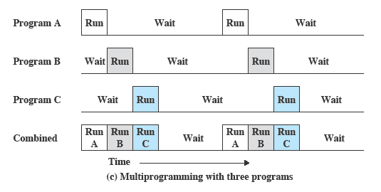
Multiprogramming
Multiprogramming
also known as multitasking
memory is expanded to hold three, four, or more programs and switch among all of them
Notes:
Furthermore, we might expand memory to hold three, four, or more
programs and switch among all of them ( Figure 2.5c ). The approach is known as
multiprogramming , or multitasking . It is the central theme of modern operating
systems.

Slide 24
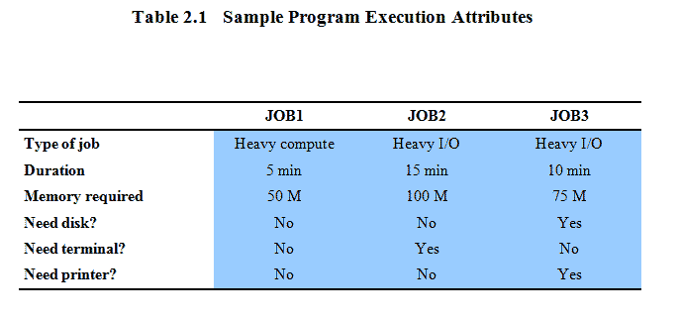
Multiprogramming Example
Notes:
To illustrate the benefit of multiprogramming, we give a simple example.
Consider a computer with 250 Mbytes of available memory (not used by the OS),
a disk, a terminal, and a printer. Three programs, JOB1, JOB2, and JOB3, are
submitted for execution at the same time, with the attributes listed in Table 2.1 .
We assume minimal processor requirements for JOB2 and JOB3 and continuous
disk and printer use by JOB3. For a simple batch environment, these jobs will be
executed in sequence. Thus, JOB1 completes in 5 minutes. JOB2 must wait until
the 5 minutes are over and then completes 15 minutes after that. JOB3 begins after
20 minutes and completes at 30 minutes from the time it was initially submitted.

Slide 25
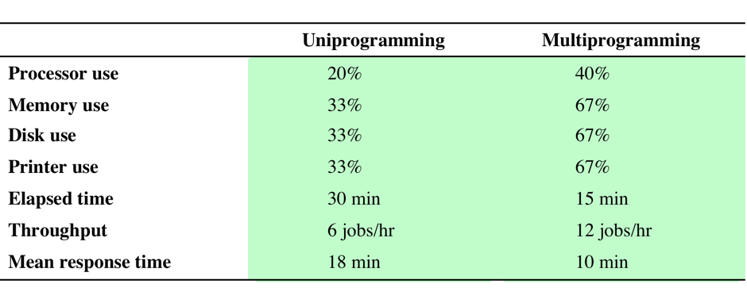
Effects on Resource Utilization
Table 2.2 Effects of Multiprogramming on Resource Utilization
Notes:
The average resource utilization, throughput, and response times are shown in the
uniprogramming column of Table 2.2 .

Slide 26
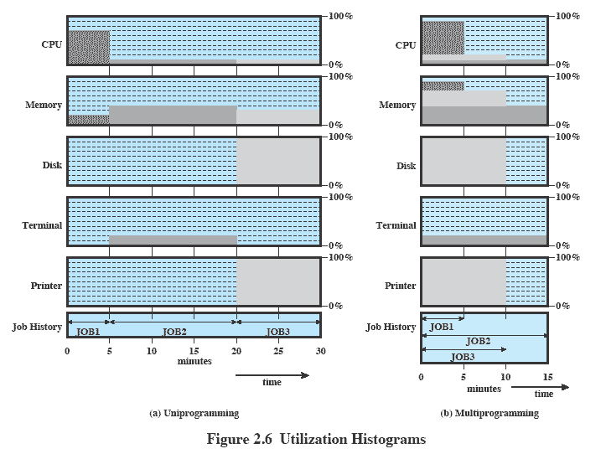
Utilization Histograms
Notes:
Device-by-device utilization is illustrated in
Figure 2.6a . It is evident that there is gross underutilization for all resources when
averaged over the required 30-minute time period.
Now suppose that the jobs are run concurrently under a multiprogramming
OS. Because there is little resource contention between the jobs, all three can run
in nearly minimum time while coexisting with the others in the computer (assuming
that JOB2 and JOB3 are allotted enough processor time to keep their input
and output operations active). JOB1 will still require 5 minutes to complete, but at
the end of that time, JOB2 will be one-third finished and JOB3 half finished. All
three jobs will have finished within 15 minutes. The improvement is evident when
examining the multiprogramming column of Table 2.2 , obtained from the histogram
shown in Figure 2.6b .

Slide 27
Time-Sharing Systems
Can be used to handle multiple interactive jobs
Processor time is shared among multiple users
Multiple users simultaneously access the system through terminals, with the OS interleaving the execution of each user program in a short burst or quantum of computation
Notes:
Just as multiprogramming allows the processor to handle multiple batch jobs
at a time, multiprogramming can also be used to handle multiple interactive jobs. In
this latter case, the technique is referred to as time sharing , because processor time is
shared among multiple users. In a time-sharing system, multiple users simultaneously
access the system through terminals, with the OS interleaving the execution of each
user program in a short burst or quantum of computation. Thus, if there are n users
actively requesting service at one time, each user will only see on the average 1/ n
of the effective computer capacity, not counting OS overhead. However, given the
relatively slow human reaction time, the response time on a properly designed system
should be similar to that on a dedicated computer.

Slide 28
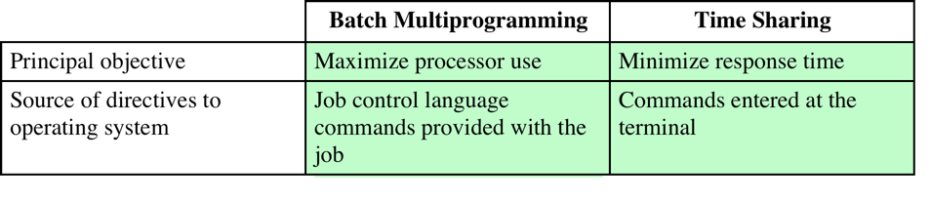
Batch Multiprogramming vs. Time Sharing
Table 2.3 Batch Multiprogramming versus Time Sharing
Notes:
Both batch processing and time sharing use multiprogramming. The key
differences are listed in Table 2.3 .

Slide 29
Compatible Time-Sharing Systems
CTSS
Time Slicing
System clock generates interrupts at a rate of approximately one every 0.2 seconds
At each interrupt OS regained control and could assign processor to another user
At regular time intervals the current user would be preempted and another user loaded in
Old user programs and data were written out to disk
Old user program code and data were restored in main memory when that program was next given a turn
One of the first time-sharing operating systems
Developed at MIT by a group known as Project MAC
Ran on a computer with 32,000 36-bit words of main memory, with the resident monitor consuming 5000 of that
To simplify both the monitor and memory management a program was always loaded to start at the location of the 5000th word
Notes:
One of the first time-sharing operating systems to be developed was the
Compatible Time-Sharing System (CTSS) [CORB62], developed at MIT by a
group known as Project MAC (Machine-Aided Cognition, or Multiple-Access
Computers). The system was first developed for the IBM 709 in 1961 and later
transferred to an IBM 7094.
Compared to later systems, CTSS is primitive. The system ran on a computer
with 32,000 36-bit words of main memory, with the resident monitor consuming 5000
of that. When control was to be assigned to an interactive user, the user’s program
and data were loaded into the remaining 27,000 words of main memory. A program
was always loaded to start at the location of the 5000th word; this simplified
both the monitor and memory management. A system clock generated interrupts
at a rate of approximately one every 0.2 seconds. At each clock interrupt, the OS
regained control and could assign the processor to another user. This technique is
known as time slicing . Thus, at regular time intervals, the current user would be
preempted and another user loaded in. To preserve the old user program status for
later resumption, the old user programs and data were written out to disk before the
new user programs and data were read in. Subsequently, the old user program code
and data were restored in main memory when that program was next given a turn.

Slide 30
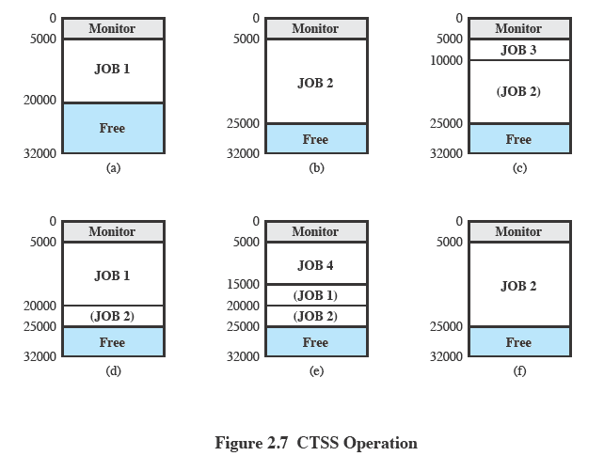
CTSS Operation
Notes:
To minimize disk traffic, user memory was only written out when the incoming
program would overwrite it. This principle is illustrated in Figure 2.7 . Assume that
there are four interactive users with the following memory requirements, in words:
• JOB1: 15,000
• JOB2: 20,000
JOB3: 5000
• JOB4: 10,000
Initially, the monitor loads JOB1 and transfers control to it (a). Later, the
monitor decides to transfer control to JOB2. Because JOB2 requires more memory
than JOB1, JOB1 must be written out first, and then JOB2 can be loaded (b).
Next, JOB3 is loaded in to be run. However, because JOB3 is smaller than JOB2,
a portion of JOB2 can remain in memory, reducing disk write time (c). Later, the
monitor decides to transfer control back to JOB1. An additional portion of JOB2
must be written out when JOB1 is loaded back into memory (d). When JOB4 is
loaded, part of JOB1 and the portion of JOB2 remaining in memory are retained
(e). At this point, if either JOB1 or JOB2 is activated, only a partial load will be
required. In this example, it is JOB2 that runs next. This requires that JOB4 and the
remaining resident portion of JOB1 be written out and that the missing portion of
JOB2 be read in (f).

Slide 31
Major Advances
Operating Systems are among the most complex pieces of software ever developed
Major advances in development include:
Memory management
Information protection and security
Scheduling and resource management
System structure
Processes
Notes:
Operating systems are among the most complex pieces of software ever developed.
This reflects the challenge of trying to meet the difficult and in some cases
competing objectives of convenience, efficiency, and ability to evolve. [DENN80a]
proposes that there have been four major theoretical advances in the development
of operating systems:
• Processes
• Memory management
• Information protection and security
• Scheduling and resource management
Each advance is characterized by principles, or abstractions, developed to
meet difficult practical problems. Taken together, these five areas span many of
the key design and implementation issues of modern operating systems. The brief
review of these five areas in this section serves as an overview of much of the rest
of the text.

Slide 32
Process
Fundamental to the structure of operating systems
A process can be defined as:
a program in execution
an instance of a running program
the entity that can be assigned to, and executed on, a processor
a unit of activity characterized by a single sequential thread of execution, a current state, and an associated set of system resources
Notes:
Central to the design of operating systems is the concept of process. This term was
first used by the designers of Multics in the 1960s [DALE68]. It is a somewhat
more general term than job. Many definitions have been given for the term process ,
including
• A program in execution
• An instance of a program running on a computer
• The entity that can be assigned to and executed on a processor
• A unit of activity characterized by a single sequential thread of execution, a
current state, and an associated set of system resources

Slide 33
Development of the Process
Three major lines of computer system development created problems in timing and synchronization that contributed to the development:
multiprogramming batch operation
processor is switched among the various programs residing in main memory
time sharing
be responsive to the individual user but be able to support many users simultaneously
real-time transaction systems
a number of users are entering queries or updates against a database
Notes:
Three major lines of computer system development created problems in timing
and synchronization that contributed to the development of the concept of the
process: multiprogramming batch operation, time sharing, and real-time transaction
systems. As we have seen, multiprogramming was designed to keep the processor
and I/O devices, including storage devices, simultaneously busy to achieve maximum
efficiency. The key mechanism is this: In response to signals indicating the
completion of I/O transactions, the processor is switched among the various programs
residing in main memory.
A second line of development was general-purpose time sharing. Here, the
key design objective is to be responsive to the needs of the individual user and yet,
for cost reasons, be able to support many users simultaneously. These goals are
compatible because of the relatively slow reaction time of the user. For example,
if a typical user needs an average of 2 seconds of processing time per minute, then
close to 30 such users should be able to share the same system without noticeable
interference. Of course, OS overhead must be factored into such calculations.
A third important line of development has been real-time transaction processing
systems. In this case, a number of users are entering queries or updates against a
database. An example is an airline reservation system. The key difference between
the transaction processing system and the time-sharing system is that the former
is limited to one or a few applications, whereas users of a time-sharing system can
engage in program development, job execution, and the use of various applications.
In both cases, system response time is paramount.

Slide 34

Causes of Errors
Improper synchronization
a program must wait until the data are available in a buffer
improper design of the signaling mechanism can result in loss or duplication
Nondeterminate program operation
program execution is interleaved by the processor when memory is shared
the order in which programs are scheduled may affect their outcome
Deadlocks
it is possible for two or more programs to be hung up waiting for each other
may depend on the chance timing of resource allocation and release
Failed mutual exclusion
more than one user or program attempts to make use of a shared resource at the same time
only one routine at at time allowed to perform an update against the file
Notes:
Efforts to design a system were vulnerable to subtle programming errors whose effects could be observed only when certain relatively rare sequences of actions occurred.
These errors were difficult to diagnose because they needed to be distinguished from application software errors and hardware errors.
Even when the error was detected, it was difficult to determine the cause, because the precise conditions under which the errors appeared were very hard to reproduce.
In general terms, there are four main causes of such errors:
Improper synchronization:
Often a routine must be suspended awaiting an event elsewhere in the system.
e.g. a program that initiates an I/O read must wait until the data are available in a buffer before proceeding.
In such cases, a signal from some other routine is required.
Improper design of the signalling mechanism can result in signals being lost or duplicate signals being received.
Failed mutual exclusion:
Often more than one user or program will attempt to make use of a shared resource at the same time.
e.g. two users may attempt to edit the same file at the same time.
If these accesses are not controlled, an error can occur.
There must be some sort of mutual exclusion mechanism that permits only one routine at a time to perform an update against the file.
Nondeterminate program operation:
The results of a particular program normally should depend only on the input to that program and not on the activities of other programs in a shared system.
But when programs share memory, and their execution is interleaved by the processor, they may interfere with each other by overwriting common memory areas in unpredictable ways.
Thus, the order in which various programs are scheduled may affect the outcome of any particular program.
Deadlocks:
It is possible for two or more programs to be hung up waiting for each other.
e.g. two programs may each require two I/O devices to perform some operation (e.g., disk to tape copy).
One of the programs has seized control of one of the devices and the other program has control of the other device.
Each is waiting for the other program to release the desired resource.
Such a deadlock may depend on the chance timing of resource allocation and release.

Slide 35
Components of a Process
A process contains three components:
an executable program
the associated data needed by the program (variables, work space, buffers, etc.)
the execution context (or “process state”) of the program
The execution context is essential:
it is the internal data by which the OS is able to supervise and control the process
includes the contents of the various process registers
includes information such as the priority of the process and whether the process is waiting for the completion of a particular I/O event
Notes:
We can think of a process as consisting of three components:
• An executable program
• The associated data needed by the program (variables, work space, buffers, etc.)
• The execution context of the program
This last element is essential.
The execution context, or process state, is the internal data by which the OS is able to supervise and control the process.
This internal information is separated from the process, because the OS has information not permitted to the process.
The context includes all of the information that the OS needs to manage the process and that the processor needs to execute the process properly including:
contents of the various processor registers, such as the program counter and data registers
And information of use to the OS, such as the priority of the process and whether the process is waiting for the completion of a particular I/O event.

Slide 36
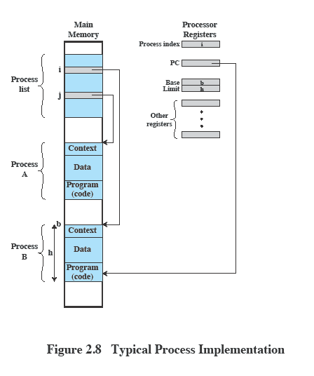
Process Management
The entire state of the process at any instant is contained in its context
New features can be designed and incorporated into the OS by expanding the context to include any new information needed to support the feature
Notes:
Figure 2.8 indicates a way in which processes may be managed. Two processes,
A and B, exist in portions of main memory. That is, a block of memory is
allocated to each process that contains the program, data, and context information.
Each process is recorded in a process list built and maintained by the OS. The
process list contains one entry for each process, which includes a pointer to the
location of the block of memory that contains the process. The entry may also
include part or all of the execution context of the process. The remainder of the
execution context is stored elsewhere, perhaps with the process itself (as indicated
in Figure 2.8 ) or frequently in a separate region of memory. The process index
register contains the index into the process list of the process currently controlling
the processor. The program counter points to the next instruction in that process
to be executed. The base and limit registers define the region in memory occupied
by the process: The base register is the starting address of the region of memory
and the limit is the size of the region (in bytes or words). The program counter and
all data references are interpreted relative to the base register and must not exceed
the value in the limit register. This prevents interprocess interference.
In Figure 2.8 , the process index register indicates that process B is executing.
Process A was previously executing but has been temporarily interrupted. The
contents of all the registers at the moment of A’s interruption were recorded in its
execution context. Later, the OS can perform a process switch and resume execution
of process A. The process switch consists of storing the context of B and restoring
the context of A. When the program counter is loaded with a value pointing into A’s
program area, process A will automatically resume execution.

Slide 37
Memory Management
The OS has five principal storage management responsibilities:
process isolation
long-term storage
protection and access control
support of modular programming
automatic allocation and management
Notes:
The needs of users can be met best by a computing environment that supports
modular programming and the flexible use of data. System managers need efficient
and orderly control of storage allocation. The OS, to satisfy these requirements, has
five principal storage management responsibilities:
• Process isolation: The OS must prevent independent processes from interfering
with each other’s memory, both data and instructions.
• Automatic allocation and management: Programs should be dynamically
allocated across the memory hierarchy as required. Allocation should be
transparent to the programmer. Thus, the programmer is relieved of concerns
relating to memory limitations, and the OS can achieve efficiency by assigning
memory to jobs only as needed.
• Support of modular programming: Programmers should be able to define program
modules, and to create, destroy, and alter the size of modules dynamically.
• Protection and access control: Sharing of memory, at any level of the memory
hierarchy, creates the potential for one program to address the memory space
of another. This is desirable when sharing is needed by particular applications.
At other times, it threatens the integrity of programs and even of the OS itself.
The OS must allow portions of memory to be accessible in various ways by
various users.
• Long-term storage: Many application programs require means for storing
information for extended periods of time, after the computer has been
powered down.

Slide 38
Virtual Memory
A facility that allows programs to address memory from a logical point of view, without regard to the amount of main memory physically available
Conceived to meet the requirement of having multiple user jobs reside in main memory concurrently
Notes:
Typically, operating systems meet these requirements with virtual memory
and file system facilities. The file system implements a long-term store, with information
stored in named objects, called files. The file is a convenient concept for the
programmer and is a useful unit of access control and protection for the OS.
Virtual memory is a facility that allows programs to address memory from
a logical point of view, without regard to the amount of main memory physically
available. Virtual memory was conceived to meet the requirement of having multiple
user jobs reside in main memory concurrently, so that there would not be a hiatus
between the execution of successive processes while one process was written out
to secondary store and the successor process was read in.

Slide 39
Paging
Allows processes to be comprised of a number of fixed-size blocks, called pages
Program references a word by means of a virtual address
consists of a page number and an offset within the page
each page may be located anywhere in main memory
Provides for a dynamic mapping between the virtual address used in the program and a real (or physical) address in main memory
Notes:
Because processes vary
in size, if the processor switches among a number of processes it is difficult to pack
them compactly into main memory. Paging systems were introduced, which allow
processes to be comprised of a number of fixed-size blocks, called pages. A program
references a word by means of a virtual address consisting of a page number
and an offset within the page. Each page of a process may be located anywhere
in main memory. The paging system provides for a dynamic mapping between the
virtual address used in the program and a real address , or physical address, in main
memory.

Slide 40
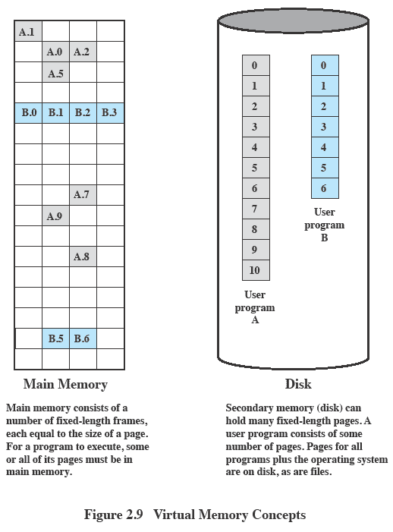
Virtual Memory
Notes:
With dynamic mapping hardware available, the next logical step was to
eliminate the requirement that all pages of a process reside in main memory simultaneously.
All the pages of a process are maintained on disk. When a process is
executing, some of its pages are in main memory. If reference is made to a page
that is not in main memory, the memory management hardware detects this and
arranges for the missing page to be loaded. Such a scheme is referred to as virtual
memory and is depicted in Figure 2.9 .
The processor hardware, together with the OS, provides the user with a
“virtual processor” that has access to a virtual memory. This memory may be a
linear address space or a collection of segments, which are variable-length blocks
of contiguous addresses. In either case, programming language instructions can
reference program and data locations in the virtual memory area. Process isolation
can be achieved by giving each process a unique, nonoverlapping virtual memory.
Memory sharing can be achieved by overlapping portions of two virtual memory
spaces. Files are maintained in a long-term store. Files and portions of files may be
copied into the virtual memory for manipulation by programs.

Slide 41
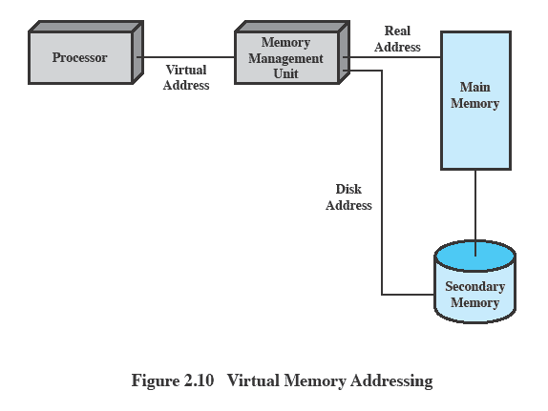
Virtual Memory Addressing
Notes:
Figure 2.10 highlights the addressing concerns in a virtual memory scheme.
Storage consists of directly addressable (by machine instructions) main memory
and lower-speed auxiliary memory that is accessed indirectly by loading blocks
into main memory. Address translation hardware (memory management unit) is
interposed between the processor and memory. Programs reference locations using
virtual addresses, which are mapped into real main memory addresses. If a reference
is made to a virtual address not in real memory, then a portion of the contents
of real memory is swapped out to auxiliary memory and the desired block of data
is swapped in. During this activity, the process that generated the address reference
must be suspended. The OS designer needs to develop an address translation mechanism
that generates little overhead and a storage allocation policy that minimizes
the traffic between memory levels.

Slide 42
Information Protection and Security
The nature of the threat that concerns an organization will vary greatly depending on the circumstances
The problem involves controlling access to computer systems and the information stored in them
Main issues
availability
confidentiality
data integrity
authenticity
Notes:
The growth in the use of time-sharing systems and, more recently, computer networks
has brought with it a growth in concern for the protection of information.
The nature of the threat that concerns an organization will vary greatly depending
on the circumstances. However, there are some general-purpose tools that can be
built into computers and operating systems that support a variety of protection and
security mechanisms. In general, we are concerned with the problem of controlling
access to computer systems and the information stored in them.
Much of the work in security and protection as it relates to operating systems
can be roughly grouped into four categories:
• Availability: Concerned with protecting the system against interruption.
• Confidentiality: Assures that users cannot read data for which access is
unauthorized.
• Data integrity: Protection of data from unauthorized modification.
• Authenticity: Concerned with the proper verification of the identity of users
and the validity of messages or data.

Slide 43
Scheduling and Resource Management
Key responsibility of an OS is managing resources
Resource allocation policies must consider:
fairness
differential responsiveness
efficiency
Notes:
A key responsibility of the OS is to manage the various resources available to it (main memory space, I/O devices, processors) and to schedule their use by the various active processes.
Any resource allocation and scheduling policy must consider three factors:
Fairness:
Typically, we would like all processes that are competing for the use of a particular resource to be given approximately equal and fair access to that resource.
This is especially so for jobs of the same class, that is, jobs of similar demands.
Differential responsiveness:
On the other hand, the OS may need to discriminate among different classes of jobs with different service requirements.
The OS should attempt to make allocation and scheduling decisions to meet the total set of requirements.
The OS should also make these decisions dynamically.
e.g. if a process is waiting for the use of an I/O device, the OS may wish to schedule that process for execution as soon as possible to free up the device for later demands from other processes.
Efficiency:
The OS should attempt to
maximize throughput,
minimize response time, and
accommodate as many users as possible.
These criteria conflict;
Finding the right balance for a particular situation is an ongoing problem for operating system research.

Slide 44
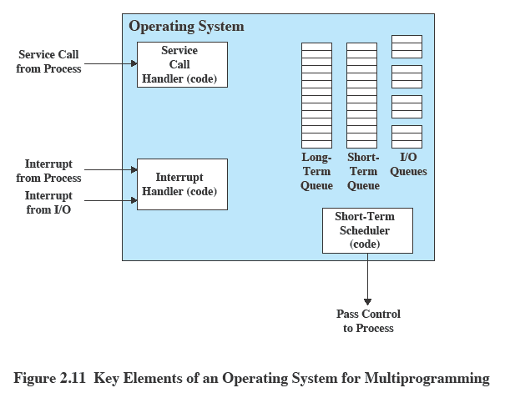
Key Elements of an Operating System
Notes:
Figure 2.11 suggests the major elements of the OS involved in the scheduling
of processes and the allocation of resources in a multiprogramming environment.
The OS maintains a number of queues, each of which is simply a list of processes
waiting for some resource. The short-term queue consists of processes that are in
main memory (or at least an essential minimum portion of each is in main memory)
and are ready to run as soon as the processor is made available. Any one of these
processes could use the processor next. It is up to the short-term scheduler, or
dispatcher, to pick one. A common strategy is to give each process in the queue
some time in turn; this is referred to as a round-robin technique. In effect, the
round-robin technique employs a circular queue. Another strategy is to assign
priority levels to the various processes, with the scheduler selecting processes in
priority order.
The long-term queue is a list of new jobs waiting to use the processor. The
OS adds jobs to the system by transferring a process from the long-term queue to
the short-term queue. At that time, a portion of main memory must be allocated
to the incoming process. Thus, the OS must be sure that it does not overcommit
memory or processing time by admitting too many processes to the system. There
is an I/O queue for each I/O device. More than one process may request the use of
the same I/O device. All processes waiting to use each device are lined up in that
device’s queue. Again, the OS must determine which process to assign to an available
I/O device.
The OS receives control of the processor at the interrupt handler if an interrupt
occurs. A process may specifically invoke some OS service, such as an I/O
device handler by means of a service call. In this case, a service call handler is the
entry point into the OS. In any case, once the interrupt or service call is handled, the
short-term scheduler is invoked to pick a process for execution.
The foregoing is a functional description; details and modular design of this
portion of the OS will differ in various systems. Much of the research and development
effort in operating systems has been directed at picking algorithms and data
structures for this function that provide fairness, differential responsiveness, and
efficiency.

Slide 45
Different Architectural Approaches
Different approaches and design elements have been tried:
Microkernel architecture
Multithreading
Symmetric multiprocessing
Distributed operating systems
Object-oriented design
Demands on operating systems require new ways of organizing the OS
Notes:
The rate of change in the demands on operating systems requires not just modifications and enhancements to existing architectures but new ways of organizing the OS.
A wide range of different approaches and design elements has been tried in both experimental and commercial operating systems, but much of the work fits into the following categories:
• Microkernel architecture
• Multithreading
• Symmetric multiprocessing
• Distributed operating systems
• Object-oriented design

Slide 46
Microkernel Architecture
Assigns only a few essential functions to the kernel:
The approach:
address spaces
interprocess communication (IPC)
basic scheduling
simplifies implementation
provides flexibility
is well suited to a distributed environment
Notes:
Most operating systems, until recently, featured a large monolithic kernel .
Most of what is thought of as OS functionality is provided in these large kernels,
including scheduling, file system, networking, device drivers, memory management,
and more. Typically, a monolithic kernel is implemented as a single process, with
all elements sharing the same address space. A microkernel architecture assigns
only a few essential functions to the kernel, including address spaces, interprocess
communication (IPC), and basic scheduling. Other OS services are provided by
processes, sometimes called servers, that run in user mode and are treated like any
other application by the microkernel. This approach decouples kernel and server
development. Servers may be customized to specific application or environment
requirements. The microkernel approach simplifies implementation, provides flexibility,
and is well suited to a distributed environment. In essence, a microkernel
interacts with local and remote server processes in the same way, facilitating construction
of distributed systems.

Slide 47
Multithreading
Technique in which a process, executing an application, is divided into threads that can run concurrently
Thread
dispatchable unit of work
includes a processor context and its own data area to enable subroutine branching
executes sequentially and is interruptible
Process
a collection of one or more threads and associated system resources
programmer has greater control over the modularity of the application and the timing of application related events
Notes:
Multithreading is a technique in which a process, executing an application, is
divided into threads that can run concurrently. We can make the following distinction:
• Thread: A dispatchable unit of work. It includes a processor context (which
includes the program counter and stack pointer) and its own data area for a
stack (to enable subroutine branching). A thread executes sequentially and is
interruptible so that the processor can turn to another thread.
• Process : A collection of one or more threads and associated system resources
(such as memory containing both code and data, open files, and devices). This
corresponds closely to the concept of a program in execution. By breaking
a single application into multiple threads, the programmer has great control
over the modularity of the application and the timing of application-related
events.
Multithreading is useful for applications that perform a number of essentially
independent tasks that do not need to be serialized. An example is a database server
that listens for and processes numerous client requests. With multiple threads running
within the same process, switching back and forth among threads involves
less processor overhead than a major process switch between different processes.
Threads are also useful for structuring processes that are part of the OS kernel as
described in subsequent chapters.

Slide 48
Symmetric Multiprocessing (SMP)
Term that refers to a computer hardware architecture and also to the OS behavior that exploits that architecture
Several processes can run in parallel
Multiple processors are transparent to the user
these processors share same main memory and I/O facilities
all processors can perform the same functions
The OS takes care of scheduling of threads or processes on individual processors and of synchronization among processors
Notes:
Symmetric multiprocessing (SMP) is a term that refers to a computer hardware
architecture (described in Chapter 1 ) and also to the OS behavior that exploits
that architecture. The OS of an SMP schedules processes or threads across all of the
processors.
Multithreading and SMP are often discussed together, but the two are
independent facilities. Even on a uniprocessor system, multithreading is useful for
structuring applications and kernel processes. An SMP system is useful even for
nonthreaded processes, because several processes can run in parallel. However, the
two facilities complement each other and can be used effectively together.
An attractive feature of an SMP is that the existence of multiple processors is
transparent to the user. The OS takes care of scheduling of threads or processes on
individual processors and of synchronization among processors.

Slide 49
SMP Advantages
Performance
more than one process can be running simultaneously, each on a different processor
Availability
failure of a single process does not halt the system
Incremental Growth
performance of a system can be enhanced by adding an additional processor
Scaling
vendors can offer a range of products based on the number of processors configured in the system
Notes:
SMP has a number of potential advantages over uniprocessor architecture,
including the following:
• Performance: If the work to be done by a computer can be organized so that
some portions of the work can be done in parallel, then a system with multiple
processors will yield greater performance than one with a single processor of
the same type. This is illustrated in Figure 2.12 . With multiprogramming, only
one process can execute at a time; meanwhile all other processes are waiting
for the processor. With multiprocessing, more than one process can be running
simultaneously, each on a different processor.
• Availability: In a symmetric multiprocessor, because all processors can perform
the same functions, the failure of a single processor does not halt the
system. Instead, the system can continue to function at reduced performance.
• Incremental growth: A user can enhance the performance of a system by adding
an additional processor.
• Scaling: Vendors can offer a range of products with different price and performance
characteristics based on the number of processors configured in the
system.
It is important to note that these are potential, rather than guaranteed, benefits. The
OS must provide tools and functions to exploit the parallelism in an SMP system.

Slide 50
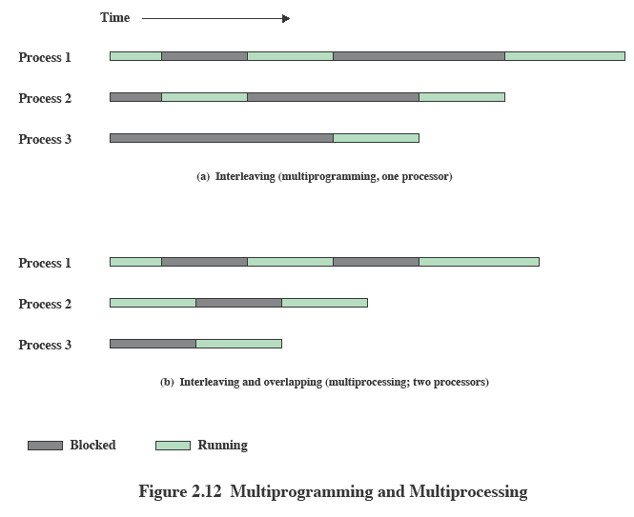
Multiprogramming Multiprocessing
Notes:
If the work to be done by a computer can be organized so that
some portions of the work can be done in parallel, then a system with multiple
processors will yield greater performance than one with a single processor of
the same type. This is illustrated in Figure 2.12 . With multiprogramming, only
one process can execute at a time; meanwhile all other processes are waiting
for the processor. With multiprocessing, more than one process can be running
simultaneously, each on a different processor.

Slide 51
OS Design
Distributed Operating System
Object-Oriented Design
Provides the illusion of
a single main memory space
single secondary memory space
unified access facilities
State of the art for distributed operating systems lags that of uniprocessor and SMP operating systems
Used for adding modular extensions to a small kernel
Enables programmers to customize an operating system without disrupting system integrity
Eases the development of distributed tools and full-blown distributed operating systems
Notes:
A different problem is to provide the appearance of a single
system for a cluster of separate computers—a multicomputer system. In this
case, we are dealing with a collection of entities (computers), each with its own
main memory, secondary memory, and other I/O modules. A distributed operating
system provides the illusion of a single main memory space and a single secondary
memory space, plus other unified access facilities, such as a distributed file system.
Although clusters are becoming increasingly popular, and there are many cluster
products on the market, the state of the art for distributed operating systems lags
that of uniprocessor and SMP operating systems. We examine such systems in
Part Eight.
Another innovation in OS design is the use of object-oriented technologies.
Object-oriented design lends discipline to the process of adding modular extensions
to a small kernel. At the OS level, an object-based structure enables programmers
to customize an OS without disrupting system integrity. Object orientation also
eases the development of distributed tools and full-blown distributed operating
systems.

Slide 52
Virtual Machines and Virtualization
Virtualization
enables a single PC or server to simultaneously run multiple operating systems or multiple sessions of a single OS
a machine can host numerous applications, including those that run on different operating systems, on a single platform
host operating system can support a number of virtual machines (VM)
each has the characteristics of a particular OS and, in some versions of virtualization, the characteristics of a particular hardware platform
Notes:
Traditionally, applications have run directly on an OS on a PC or a server. Each PC
or server would run only one OS at a time. Thus, the vendor had to rewrite parts
of its applications for each OS/platform they would run on. An effective strategy
for dealing with this problem is known as virtualization . Virtualization technology
enables a single PC or server to simultaneously run multiple operating systems or
multiple sessions of a single OS. A machine with virtualization can host numerous
applications, including those that run on different operating systems, on a single
platform. In essence, the host operating system can support a number of virtual
machines (VM) , each of which has the characteristics of a particular OS and, in some
versions of virtualization, the characteristics of a particular hardware platform.
The VM approach is becoming a common way for businesses and individuals
to deal with legacy applications and to optimize their hardware usage by maximizing
the number of kinds of applications that a single computer can handle [GEER09].
Commercial VM offerings by companies such as VMware and Microsoft are widely
used, with millions of copies having been sold. In addition to their use in server
environments, these VM technologies also are used in desktop environments to run
multiple operating systems, typically Windows and Linux.

Slide 53
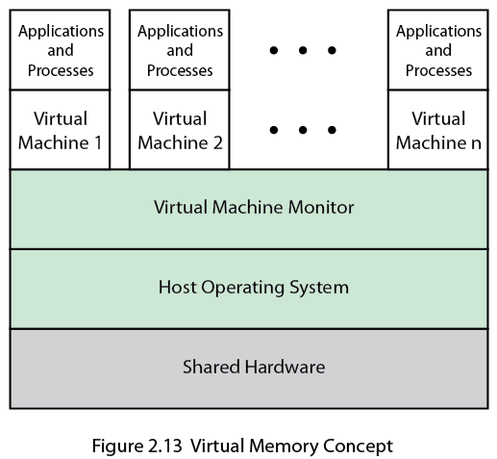
Virtual
Memory Concept
Notes:
The specific architecture of the VM approach varies among vendors.
Figure 2.13 shows a typical arrangement. The virtual machine monitor (VMM) , or
hypervisor , runs on top of (or is incorporated into) the host OS. The VMM supports
VMs, which are emulated hardware devices. Each VM runs a separate OS.
The VMM handles each operating system’s communications with the processor,
the storage medium, and the network. To execute programs, the VMM hands off
the processor control to a virtual OS on a VM. Most VMs use virtualized network
connections to communicate with one another, when such communication is needed.
Key to the success of this approach is that the VMM provides a layer between software
environments and the underlying hardware and host OS that is programmable,
transparent to the software above it, and makes efficient use of the hardware
below it.

Slide 54
Virtual Machine Architecture
Process perspective:
the machine on which it executes consists of the virtual memory space assigned to the process
the processor registers it may use
the user-level machine instructions it may execute
OS system calls it may invoke for I/O
ABI defines the machine as seen by a process
Application perspective:
machine characteristics are specified by high-level language capabilities and OS system library calls
API defines the machine for an application
OS perspective:
processes share a file system and other I/O resources
system allocates real memory and I/O resources to the processes
ISA provides the interface between the system and machine
Notes:
Recall from Section 2.1 (see Figure 2.1 ) the discussion of the application programming
interface, the application binary interface, and the instruction set architecture.
Let us use these interface concepts to clarify the meaning of machine in
the term virtual machine. Consider a process executing a compiled application
program. From the perspective of the process , the machine on which it executes
consists of the virtual memory space assigned to the process, the processor registers
it may use, the user-level machine instructions it may execute, and the OS
system calls it may invoke for I/O. Thus the ABI defines the machine as seen by
a process.
From the perspective of an application , the machine characteristics are specified
by high-level language capabilities, and OS and system library calls. Thus, the
API defines the machine for an application.
For the operating system , the machine hardware defines the system that
supports the operation of the OS and the numerous processes that execute concurrently.
These processes share a file system and other I/O resources. The system
allocates real memory and I/O resources to the processes and allows the processes
to interact with their resources. From the OS perspective, therefore, it is the ISA
that provides the interface between the system and machine.
With these considerations in mind, we can consider two architectural
approaches to implementing virtual machines: process VMs and system VMs.

Slide 55
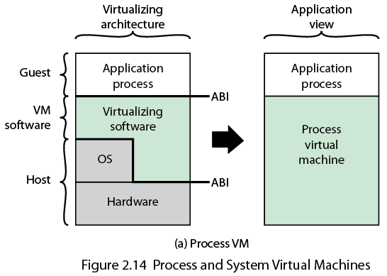
Process and System Virtual Machines
Notes:
In essence, a process VM presents an ABI to an
application process, translates a set of OS and user-level instructions composing one
platform to those of another ( Figure 2.14a ). A process VM is a virtual platform for
executing a single process. As such, the process VM is created when the process is
created and terminated when the process is terminated.
In order to provide cross-platform portability, a common implementation of
the process VM architecture is as part of an overall HLL application environment.
The resulting ABI does not correspond to any specific machine. Instead, the ABI
specification is designed to easily support a given HLL or set of HLLs and to be easily
portable to a variety of ISAs. The HLL VM includes a front-end compiler that
generates a virtual binary code for execution or interpretation. This code can then
be executed on any machine that has the process VM implemented.
Two widely used examples of this approach are the Java VM architecture and
the Microsoft Common Language Infrastructure, which is the foundation of the
.NET framework.

Slide 56
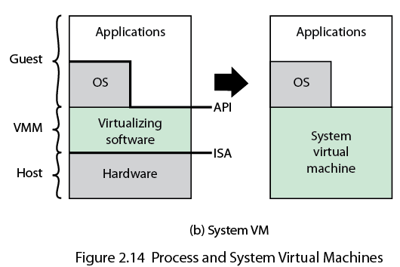
Process and System Virtual Machines
Notes:
In a system VM, virtualizing software translates the
ISA used by one hardware platform to that of another. Note in Figure 2.14a that
the virtualizing software in the process VM approach makes use of the services of
the host OS, while in the system VM approach there is logically no separate host
OS, rather the host system OS incorporates the VM capability. In the system VM
case, the virtualizing software is host to a number of guest operating systems, with
each VM including its own OS. The VMM emulates the hardware ISA so that the
guest software can potentially execute a different ISA from the one implemented
on the host.
With the system VM approach, a single hardware platform can support multiple,
isolated guest OS environments simultaneously. This approach provides a
number of benefits, including application portability, support of legacy systems
without the need to maintain legacy hardware, and security by means of isolation of
each guest OS environment from the other guest environments.
A variant on the architecture shown in Figure 2.14b is referred to as a hosted
VM. In this case, the VMM is built on top of an existing host OS. The VMM relies
on the host OS to provide device drivers and other lower-level services. An example
of a hosted VM is the VMware GSX server.

Slide 57
Symmetric Multiprocessor OS Considerations
A multiprocessor OS must provide all the functionality of a multiprogramming system plus additional features to accommodate multiple processors
Key design issues:
Simultaneous concurrent processes or threads
kernel routines need to be reentrant to allow several processors to execute the same kernel code simultaneously
Scheduling
any processor may perform scheduling, which complicates the task of enforcing a scheduling policy
Synchronization
with multiple active processes having potential access to shared address spaces or shared I/O resources, care must be taken to provide effective synchronization
Memory management
the reuse of physical pages is the biggest problem of concern
Reliability and fault tolerance
the OS should provide graceful degradation in the face of processor failure
Notes:
In an SMP system, the kernel can execute on any processor, and typically each
processor does self-scheduling from the pool of available processes or threads.
The kernel can be constructed as multiple processes or multiple threads, allowing
portions of the kernel to execute in parallel. The SMP approach complicates the OS.
The OS designer must deal with the complexity due to sharing resources (like data
structures) and coordinating actions (like accessing devices) from multiple parts of
the OS executing at the same time. Techniques must be employed to resolve and
synchronize claims to resources.
An SMP operating system manages processor and other computer resources
so that the user may view the system in the same fashion as a multiprogramming
uniprocessor system. A user may construct applications that use multiple processes
or multiple threads within processes without regard to whether a single processor
or multiple processors will be available. Thus, a multiprocessor OS must provide all
the functionality of a multiprogramming system plus additional features to accommodate
multiple processors. The key design issues include the following:
• Simultaneous concurrent processes or threads: Kernel routines need to be
reentrant to allow several processors to execute the same kernel code simultaneously.
With multiple processors executing the same or different parts of the
kernel, kernel tables and management structures must be managed properly
to avoid data corruption or invalid operations.
• Scheduling: Any processor may perform scheduling, which complicates the
task of enforcing a scheduling policy and assuring that corruption of the scheduler
data structures is avoided. If kernel-level multithreading is used, then the
opportunity exists to schedule multiple threads from the same process simultaneously
on multiple processors. Multiprocessor scheduling is examined in
Chapter 10 .
• Synchronization: With multiple active processes having potential access to
shared address spaces or shared I/O resources, care must be taken to provide
effective synchronization. Synchronization is a facility that enforces mutual
exclusion and event ordering. A common synchronization mechanism used in
multiprocessor operating systems is locks, described in Chapter 5 .
• Memory management: Memory management on a multiprocessor must deal
with all of the issues found on uniprocessor computers and is discussed in Part
Three. In addition, the OS needs to exploit the available hardware parallelism
to achieve the best performance. The paging mechanisms on different processors
must be coordinated to enforce consistency when several processors
share a page or segment and to decide on page replacement. The reuse of
physical pages is the biggest problem of concern; that is, it must be guaranteed
that a physical page can no longer be accessed with its old contents before the
page is put to a new use.
Reliability and fault tolerance: The OS should provide graceful degradation
in the face of processor failure. The scheduler and other portions of the OS
must recognize the loss of a processor and restructure management tables
accordingly.
Because multiprocessor OS design issues generally involve extensions to
solutions to multiprogramming uniprocessor design problems, we do not treat
multiprocessor operating systems separately. Rather, specific multiprocessor issues
are addressed in the proper context throughout this book.

Slide 58
Multicore OS Considerations
The design challenge for a many-core multicore system is to efficiently harness the multicore processing power and intelligently manage the substantial on-chip resources efficiently
Potential for parallelism exists at three levels:
hardware parallelism within each core processor, known as instruction level parallelism
potential for multiprogramming and multithreaded execution within each processor
potential for a single application to execute in concurrent processes or threads across multiple cores
Notes:
far in this section for SMP systems. But additional concerns arise. The issue is one
of the scale of the potential parallelism. Current multicore vendors offer systems
with up to eight cores on a single chip. With each succeeding processor technology
generation, the number of cores and the amount of shared and dedicated cache
memory increases, so that we are now entering the era of “many-core” systems.
The design challenge for a many-core multicore system is to efficiently
harness the multicore processing power and intelligently manage the substantial
on-chip resources efficiently. A central concern is how to match the inherent parallelism
of a many-core system with the performance requirements of applications.
The potential for parallelism in fact exists at three levels in contemporary multicore
system. First, there is hardware parallelism within each core processor, known as
instruction level parallelism, which may or may not be exploited by application programmers
and compilers. Second, there is the potential for multiprogramming and
multithreaded execution within each processor. Finally, there is the potential for
a single application to execute in concurrent processes or threads across multiple
cores. Without strong and effective OS support for the last two types of parallelism
just mentioned, hardware resources will not be efficiently used.
In essence, then, since the advent of multicore technology, OS designers have
been struggling with the problem of how best to extract parallelism from computing
workloads. A variety of approaches are being explored for next-generation operating
systems. We introduce two general strategies in this section and consider some
details in later chapters.

Slide 59
Grand Central Dispatch
Developer must decide what pieces can or should be executed simultaneously or in parallel
Grand Central Dispatch (GCD)
implemented in Mac Os X 10.6
helps a developer once something has been identified that can be split off into a separate task
thread pool mechanism
allows anonymous functions as a way of specifying tasks
Notes:
Most applications can, in principle, be
subdivided into multiple tasks that can execute in parallel, with these tasks then
being implemented as multiple processes, perhaps each with multiple threads. The
difficulty is that the developer must decide how to split up the application work into
independently executable tasks. That is, the developer must decide what pieces can
or should be executed asynchronously or in parallel. It is primarily the compiler and
the programming language features that support the parallel programming design
process. But, the OS can support this design process, at minimum, by efficiently
allocating resources among parallel tasks as defined by the developer.
Perhaps the most effective initiative to support developers is implemented in
the latest release of the UNIX-based Mac OS X operating system. Mac OS X 10.6
includes a multicore support capability known as Grand Central Dispatch (GCD).
GCD does not help the developer decide how to break up a task or application into
separate concurrent parts. But once a developer has identified something that can
be split off into a separate task, GCD makes it as easy and noninvasive as possible
to actually do so.
In essence, GCD is a thread pool mechanism, in which the OS maps tasks onto
threads representing an available degree of concurrency (plus threads for blocking
on I/O). Windows also has a thread pool mechanism (since 2000), and thread
pools have been heavily used in server applications for years. What is new in GCD
is the extension to programming languages to allow anonymous functions (called
blocks) as a way of specifying tasks. GCD is hence not a major evolutionary step.
Nevertheless, it is a new and valuable tool for exploiting the available parallelism of
a multicore system.
One of Apple’s slogans for GCD is “islands of serialization in a sea of concurrency.”
That captures the practical reality of adding more concurrency to run-of-the-mill
desktop applications. Those islands are what isolate developers from the thorny
problems of simultaneous data access, deadlock, and other pitfalls of multithreading.
Developers are encouraged to identify functions of their applications that would be
better executed off the main thread, even if they are made up of several sequential or
otherwise partially interdependent tasks. GCD makes it easy to break off the entire
unit of work while maintaining the existing order and dependencies between subtasks.
In later chapters, we look at some of the details of GCD.

Slide 60
Virtual Machine Approach
Allows one or more cores to be dedicated to a particular process and then leave the processor alone to devote its efforts to that process
Multicore OS could then act as a hypervisor that makes a high-level decision to allocate cores to applications but does little in the way of resource allocation beyond that
Notes:
An alternative approach is to recognize that
with the ever-increasing number of cores on a chip, the attempt to multiprogram
individual cores to support multiple applications may be a misplaced use of
resources [JACK10]. If instead, we allow one or more cores to be dedicated to a
particular process and then leave the processor alone to devote its efforts to that
process, we avoid much of the overhead of task switching and scheduling decisions.
The multicore OS could then act as a hypervisor that makes a high-level decision
to allocate cores to applications but does little in the way of resource allocation
beyond that.
The reasoning behind this approach is as follows. In the early days of computing,
one program was run on a single processor. With multiprogramming,
each application is given the illusion that it is running on a dedicated processor.
Multiprogramming is based on the concept of a process, which is an abstraction of
an execution environment. To manage processes, the OS requires protected space,
free from user and program interference. For this purpose, the distinction between
kernel mode and user mode was developed. In effect, kernel mode and user mode
abstracted the processor into two processors. With all these virtual processors, however,
come struggles over who gets the attention of the real processor. The overhead
of switching between all these processors starts to grow to the point where responsiveness
suffers, especially when multiple cores are introduced. But with many-core
systems, we can consider dropping the distinction between kernel and user mode.
In this approach, the OS acts more like a hypervisor. The programs themselves take
on many of the duties of resource management. The OS assigns an application a
processor and some memory, and the program itself, using metadata generated by
the compiler, would best know how to use these resources.

Slide 61
Microsoft Windows Overview
MS-DOS 1.0 released in 1981
4000 lines of assembly language source code
ran in 8 Kbytes of memory
used Intel 8086 microprocessor
Windows 3.0 shipped in 1990
16-bit
GUI interface
implemented as a layer on top of MS-DOS
Windows 95
32-bit version
led to the development of Windows 98 and Windows Me
Windows NT (3.1) released in 1993
32-bit OS with the ability to support older DOS and Windows applications as well as provide OS/2 support
Windows 2000
included services and functions to support distributed processing
Active Directory
plug-and-play and power-management facilities
Windows XP released in 2001
goal was to replace the versions of Windows based on MS-DOS with an OS based on NT
Windows Vista shipped in 2007
Windows Server released in 2008
Windows 7 shipped in 2009, as well as Windows Server 2008 R2
Windows Azure
targets cloud computing
Notes:
The story of Windows begins with a very different OS, developed by Microsoft for
the first IBM personal computer and referred to as MS-DOS. The initial version,
MS-DOS 1.0, was released in August 1981. It consisted of 4000 lines of assembly
language source code and ran in 8 Kbytes of memory using the Intel 8086
microprocessor.
The IBM PC was an important stage in a continuing revolution in computing
that has expanded computing from the data center of the 1960s, to the departmental
minicomputer of the 1970s, and to the desktop in the 1980s. The revolution has continued
with computing moving into the briefcase in the 1990s, and into our pockets
during the most recent decade.
Microsoft’s initial OS ran a single application at a time, using a command line
interface to control the system. It took a long time for Microsoft to develop a true
GUI interface for the PC; on their third try they succeeded. The 16-bit Windows
3.0 shipped in 1990 and instantly became successful, selling a million copies in six
months. Windows 3.0 was implemented as a layer on top of MS-DOS and suffered
from the limitations of that primitive system. Five years later, Microsoft shipped a
32-bit version, Windows 95, which was also very successful and led to the development
of additional versions: Windows 98 and Windows Me.
Meanwhile, it had become clear to Microsoft that the MS-DOS platform could
not sustain a truly modern OS. In 1989 Microsoft hired Dave Cutler, who had developed
the very successful RSX-11M and VAX/VMS operating systems at Digital
Equipment Corporation. Cutler’s charter was to develop a modern OS, which was
portable to architectures other than the Intel x86 family, and yet compatible with
the OS/2 system that Microsoft was jointly developing with IBM, as well as the portable
UNIX standard, POSIX. This system was christened NT (New Technology).
The first version of Windows NT (3.1) was released in 1993, with the same GUI
as Windows 3.1, the follow-on to Windows 3.0. However, NT 3.1 was a new 32-bit
OS with the ability to support older DOS and Windows applications as well as provide
OS/2 support. Several versions of NT 3.x followed with support for additional
hardware platforms. In 1996, Microsoft released NT 4.0 with the same user interface
as Windows 95. In 2000, Microsoft introduced the next major upgrade of the NT OS:
Windows 2000. The underlying Executive and Kernel architecture is fundamentally
the same as in NT 3.1, but new features have been added. The emphasis in Windows
2000 was the addition of services and functions to support distributed processing.
The central element of Windows 2000’s new features was Active Directory, which
is a distributed directory service able to map names of arbitrary objects to any kind
of information about those objects. Windows 2000 also added the plug-and-play
and power-management facilities that were already in Windows 98, the successor to
Windows 95. These features are particularly important for laptop computers.
In 2001, a new desktop version of NT was released, known as Windows XP.
The goal of Windows XP was to finally replace the versions of Windows based on
MS-DOS with an OS based on NT. In 2007, Microsoft shipped Windows Vista for
the desktop and a short time later, Windows Server 2008. In 2009, they shipped
Windows 7 and Windows Server 2008 R2. Despite the difference in naming, the
client and server versions of these systems use many of the same files, but with additional
features and capabilities enabled for servers.
Over the years, NT has attempted to support multiple processor architectures;
the Intel i860 was the original target for NT as well as the x86. Subsequently, NT
added support for the Digital Alpha architecture, the PowerPC, and the MIPS.
Later came the Intel IA64 (Itanium) and the 64-bit version of the x86, based on
the AMD64 processor architecture. Windows 7 supports only x86 and AMD64.
Windows Server 2008 R2 supports only AMD64 and IA64—but Microsoft has
announced that it will end support for IA64 in future releases. All the other processor
architectures have failed in the market, and today only the x86, AMD64, and
ARM architectures are viable. Microsoft’s support for ARM is limited to their
Windows CE OS, which runs on phones and handheld devices. Windows CE has
little relationship to the NT-based Windows that runs on slates, netbooks/laptops,
desktops, and servers.
Microsoft has announced that it is developing a version of NT that targets
cloud computing: Windows Azure. Azure includes a number of features that are
specific to the requirements of public and private clouds. Though it is closely related
to Windows Server, it does not share files in the same way that the Windows client
and server versions do.

Slide 62
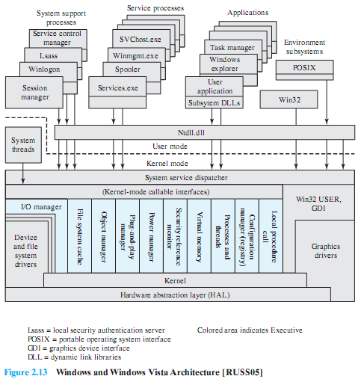
Windows Architecture
Notes:
Figure 2.15 illustrates the overall structure of Windows 7; all releases of Windows
based on NT have essentially the same structure at this level of detail.
As with virtually all operating systems, Windows separates application-oriented
software from the core OS software. The latter, which includes the Executive, the
Kernel, device drivers, and the hardware abstraction layer, runs in kernel mode.
Kernel mode software has access to system data and to the hardware. The remaining
software, running in user mode, has limited access to system data.
Windows has a highly modular architecture.
Each system function is managed by just one component of the OS. The rest of the
OS and all applications access that function through the responsible component using
standard interfaces. Key system data can only be accessed through the appropriate
function. In principle, any module can be removed, upgraded, or replaced without
rewriting the entire system or its standard application program interfaces (APIs)

Slide 63
Kernel-Mode Components of Windows
Executive
contains the core OS services
Kernel
controls execution of the processors
Hardware Abstraction Layer (HAL)
maps between generic hardware commands and responses and those unique to a specific platform
Device Drivers
dynamic libraries that extend the functionality of the Executive
Windowing and Graphics System
implements the GUI functions
Notes:
The kernel-mode components of Windows are the following:
• Executive: Contains the core OS services, such as memory management, process
and thread management, security, I/O, and interprocess communication.
• Kernel: Controls execution of the processors. The Kernel manages thread
scheduling, process switching, exception and interrupt handling, and multiprocessor
synchronization. Unlike the rest of the Executive and the user level,
the Kernel’s own code does not run in threads.
• Hardware abstraction layer (HAL): Maps between generic hardware commands
and responses and those unique to a specific platform. It isolates
the OS from platform-specific hardware differences. The HAL makes each
computer’s system bus, direct memory access (DMA) controller, interrupt
controller, system timers, and memory controller look the same to the
Executive and Kernel components. It also delivers the support needed for
SMP, explained subsequently.
• Device drivers: Dynamic libraries that extend the functionality of the
Executive. These include hardware device drivers that translate user I/O function
calls into specific hardware device I/O requests and software components
for implementing file systems, network protocols, and any other system extensions
that need to run in kernel mode.
• Windowing and graphics system: Implements the GUI functions, such as dealing
with windows, user interface controls, and drawing.
The Windows Executive includes components for specific system functions
and provides an API for user-mode software. Following is a brief description of
each of the Executive modules:
• I/O manager: Provides a framework through which I/O devices are accessible
to applications, and is responsible for dispatching to the appropriate device
drivers for further processing. The I/O manager implements all the Windows
I/O APIs and enforces security and naming for devices, network protocols,
and file systems (using the object manager). Windows I/O is discussed in
Chapter 11 .
• Cache manager: Improves the performance of file-based I/O by causing
recently referenced file data to reside in main memory for quick access, and
deferring disk writes by holding the updates in memory for a short time before
sending them to the disk in more efficient batches.
• Object manager: Creates, manages, and deletes Windows Executive objects
that are used to represent resources such as processes, threads, and synchronization
objects. It enforces uniform rules for retaining, naming, and setting the
security of objects. The object manager also creates the entries in each processes’
handle table, which consist of access control information and a pointer
to the object. Windows objects are discussed later in this section.
• Plug-and-play manager: Determines which drivers are required to support a
particular device and loads those drivers.
Power manager: Coordinates power management among various devices
and can be configured to reduce power consumption by shutting down idle
devices, putting the processor to sleep, and even writing all of memory to disk
and shutting off power to the entire system.
• Security reference monitor: Enforces access-validation and audit-generation
rules. The Windows object-oriented model allows for a consistent and uniform
view of security, right down to the fundamental entities that make up the
Executive. Thus, Windows uses the same routines for access validation and
for audit checks for all protected objects, including files, processes, address
spaces, and I/O devices. Windows security is discussed in Chapter 15 .
• Virtual memory manager: Manages virtual addresses, physical memory, and
the paging files on disk. Controls the memory management hardware and data
structures which map virtual addresses in the process’s address space to physical
pages in the computer’s memory. Windows virtual memory management is
described in Chapter 8 .
• Process/thread manager: Creates, manages, and deletes process and thread
objects. Windows process and thread management are described in Chapter 4 .
• Configuration manager: Responsible for implementing and managing the
system registry, which is the repository for both system-wide and per-user
settings of various parameters.
• Advanced local procedure call (ALPC) facility: Implements an efficient crossprocess
procedure call mechanism for communication between local processes
implementing services and subsystems. Similar to the remote procedure call
(RPC) facility used for distributed processing.

Slide 64
User-Mode Processes
Four basic types are supported by Windows:
Special System Processes
user-mode services needed to manage the system
Service Processes
the printer spooler, event logger, and user-mode components that cooperate with device drivers, and various network services
Environment Subsystems
provide different OS personalities (environments)
User Applications
executables (EXEs) and DLLs that provide the functionality users run to make use of the system
Notes:
USER-MODE PROCESSES Four basic types of user-mode processes are supported
by Windows:
• Special system processes: User-mode services needed to manage the system,
such as the session manager, the authentication subsystem, the service manager,
and the logon process.
• Service processes: The printer spooler, the event logger, user-mode components
that cooperate with device drivers, various network services, and many,
many others. Services are used by both Microsoft and external software developers
to extend system functionality as they are the only way to run background
user-mode activity on a Windows system.
• Environment subsystems: Provide different OS personalities (environments).
The supported subsystems are Win32 and POSIX. Each environment subsystem
includes a subsystem process shared among all applications using the
subsystem and dynamic link libraries (DLLs) that convert the user application
calls to ALPC calls on the subsystem process, and/or native Windows calls.
• User applications: Executables (EXEs) and DLLs that provide the functionality
users run to make use of the system. EXEs and DLLs are generally targeted
at a specific environment subsystem; although some of the programs that are
provided as part of the OS use the native system interfaces (NT API). There is
also support for running 32-bit programs on 64-bit systems.

Slide 65
Client/Server Model
Windows OS services, environmental subsystems, and applications are all structured using the client/server model
Common in distributed systems, but can be used internal to a single system
Processes communicate via RPC
Advantages:
it simplifies the Executive
it improves reliability
it provides a uniform means for applications to communicate with services via RPCs without restricting flexibility
it provides a suitable base for distributed computing
Notes:
The Windows OS services, the environment subsystems, and the applications are
structured using the client/server computing model, which is a common model for
distributed computing and which is discussed in Part Six. This same architecture can
be adopted for use internally to a single system, as is the case with Windows.
The native NT API is a set of kernel-based services which provide the core
abstractions used by the system, such as processes, threads, virtual memory, I/O,
and communication. Windows provides a far richer set of services by using the
client/server model to implement functionality in user-mode processes. Both the
environment subsystems and the Windows user-mode services are implemented as
processes that communicate with clients via RPC. Each server process waits for a
request from a client for one of its services (e.g., memory services, process creation
services, or networking services). A client, which can be an application program
or another server program, requests a service by sending a message. The message
is routed through the Executive to the appropriate server. The server performs
the requested operation and returns the results or status information by means of
another message, which is routed through the Executive back to the client.
Advantages of a client/server architecture include the following:
• It simplifies the Executive. It is possible to construct a variety of APIs implemented
in user-mode servers without any conflicts or duplications in the
Executive. New APIs can be added easily.
• It improves reliability. Each new server runs outside of the kernel, with its
own partition of memory, protected from other servers. A single server can
fail without crashing or corrupting the rest of the OS.
• It provides a uniform means for applications to communicate with services via
RPCs without restricting flexibility. The message-passing process is hidden
from the client applications by function stubs, which are small pieces of code
which wrap the RPC call. When an application makes an API call to an environment
subsystem or a service, the stub in the client application packages the
parameters for the call and sends them as a message to the server process that
implements the call.

Slide 66
Threads and SMP
Two important characteristics of Windows are its support for threads and for symmetric multiprocessing (SMP)
OS routines can run on any available processor, and different routines can execute simultaneously on different processors
Windows supports the use of multiple threads of execution within a single process. Multiple threads within the same process may execute on different processors simultaneously
Server processes may use multiple threads to process requests from more than one client simultaneously
Windows provides mechanisms for sharing data and resources between processes and flexible interprocess communication capabilities
Notes:
Two important characteristics of Windows are its support for threads and for
symmetric multiprocessing (SMP), both of which were introduced in Section 2.4 .
[RUSS11] lists the following features of Windows that support threads and SMP:
• OS routines can run on any available processor, and different routines can
execute simultaneously on different processors.
• Windows supports the use of multiple threads of execution within a single
process. Multiple threads within the same process may execute on different
processors simultaneously.
• Server processes may use multiple threads to process requests from more than
one client simultaneously.
• Windows provides mechanisms for sharing data and resources between processes
and flexible interprocess communication capabilities.

Slide 67
Windows Objects
Windows draws heavily on the concepts of object-oriented design
Key object-oriented concepts used by Windows are:
Encapsulation
Object class and instance
Inheritance
Polymorphism
Notes:
Though the core of Windows is written in C, the design principles followed draw
heavily on the concepts of object-oriented design. This approach facilitates the sharing
of resources and data among processes and the protection of resources from
unauthorized access. Among the key object-oriented concepts used by Windows are
the following:
• Encapsulation: An object consists of one or more items of data, called
attributes, and one or more procedures that may be performed on those data,
called services. The only way to access the data in an object is by invoking one
of the object’s services. Thus, the data in the object can easily be protected
from unauthorized use and from incorrect use (e.g., trying to execute a nonexecutable
piece of data).
• Object class and instance: An object class is a template that lists the attributes
and services of an object and defines certain object characteristics. The OS can
create specific instances of an object class as needed. For example, there is a
single process object class and one process object for every currently active
process. This approach simplifies object creation and management.
• Inheritance: Although the implementation is hand coded, the Executive uses
inheritance to extend object classes by adding new features. Every Executive
class is based on a base class which specifies virtual methods that support
creating, naming, securing, and deleting objects. Dispatcher objects are
Executive objects that inherit the properties of an event object, so they can
use common synchronization methods. Other specific object types, such as the
device class, allow classes for specific devices to inherit from the base class,
and add additional data and methods.
• Polymorphism: Internally, Windows uses a common set of API functions to
manipulate objects of any type; this is a feature of polymorphism, as defined
in Appendix D . However, Windows is not completely polymorphic because
there are many APIs that are specific to a single object type.

Slide 68
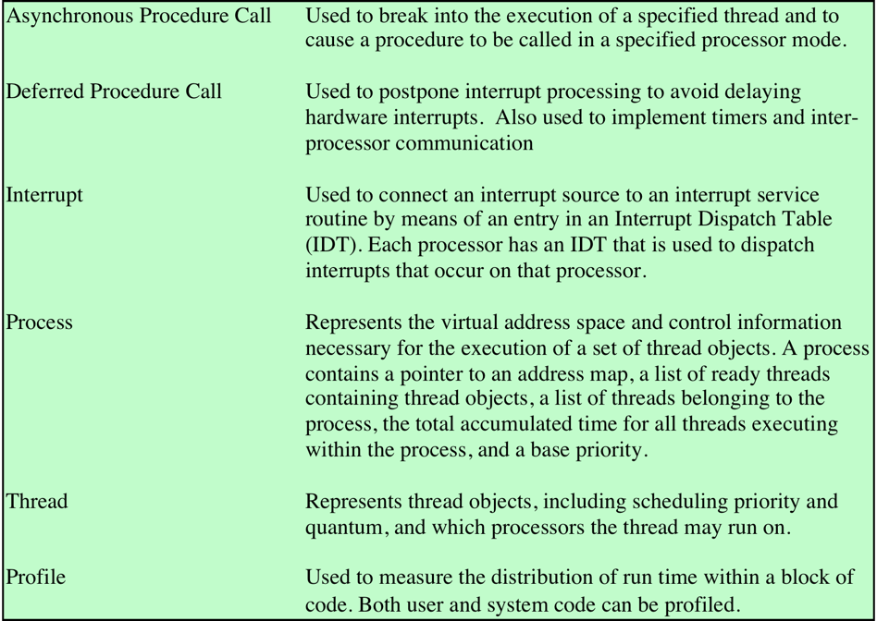
Windows Kernel Control Objects
Notes:
There are two categories of objects used by Windows for synchronizing the
use of the processor:
• Dispatcher objects: The subset of Executive objects which threads can wait on
to control the dispatching and synchronization of thread-based system operations.
These are described in Chapter 6 .
• Control objects: Used by the Kernel component to manage the operation of
the processor in areas not managed by normal thread scheduling. Table 2.4
lists the Kernel control objects.
Windows is not a full-blown object-oriented OS. It is not implemented in
an object-oriented language. Data structures that reside completely within one
Executive component are not represented as objects. Nevertheless, Windows illustrates
the power of object-oriented technology and represents the increasing trend
toward the use of this technology in OS design.

Slide 69
Windows 7
Changes and improvements:
Engineering improvements
the system is now built in layers which can be separately tested
Performance improvements
amount of memory required has been reduced
Reliability improvements
user-mode heap is more tolerant of memory allocation errors by C/C++ programmers
Energy efficiency
many improvements have been made
Security
BitLocker is now easier to set up and use
Thread improvements
can support hundreds of CPUs
Dynamic Fair Share Scheduling (DFSS)
Notes:
The core architecture of Windows has been very stable; however, at each release
there are new features and improvements made even at the lower levels of the system.
Many of the changes in Windows are not visible in the features themselves,
but in the performance and stability of the system. These are due to changes in
the engineering behind Windows. Other improvements are due to new features, or
improvements to existing features:
Engineering improvements: The performance of hundreds of key scenarios,
such as opening a file from the GUI, are tracked and continuously characterized
to identify and fix problems. The system is now built in layers which can
be separately tested, improving modularity and reducing complexity.
• Performance improvements: The amount of memory required has been
reduced, both for clients and servers. The VMM is more aggressive about
limiting the memory use of runaway processes (see Section 8.5 ). Background
processes can arrange to start upon an event trigger, such as a plugging in a
camera, rather than running continuously.
• Reliability improvements: The user-mode heap is more tolerant of memory
allocation errors by C/C++ programmers, such as continuing to use memory
after it is freed. Programs that make such errors are detected and the heap
allocation policies are modified for that program to defer freeing memory and
avoid corruption of the program’s data.
• Energy efficiency: Many improvements have been made to the energy efficiency
of Windows. On servers, unused processors can be “parked,” reducing
their energy use. All Windows systems are more efficient in how the timers
work; avoiding timer interrupts and the associated background activity allows
the processors to remain idle longer, which allows modern processors to consume
less energy. Windows accomplishes this by coalescing timer interrupts
into batches.
• Security: Windows 7 builds on the security features in Windows Vista, which
added integrity levels to the security model, provided BitLocker volume
encryption (see Section 15.6 ), and limited privileged actions by ordinary users.
BitLocker is now easier to set up and use, and privileged actions result in
many fewer annoying GUI pop-ups.
• Thread improvements: The most interesting Windows 7 changes were in the
Kernel. The number of logical CPUs available on each system is growing
dramatically. Previous versions of Windows limited the number of CPUs to
64, because of the bitmasks used to represent values like processor affinity
(see Section 4.4 ). Windows 7 can support hundreds of CPUs. To ensure that
the performance of the system scaled with the number of CPUs, major
improvements were made to the Kernel-scheduling code to break apart locks
and reduce contention. As the number of available CPUs increase, new
programming environments are being developed to support the finer-grain
parallelism than is available with threads. Windows 7 supports a form of User-
Mode Scheduling which separates the user-mode and kernel-mode portions
of threads, allowing the user-mode portions to yield the CPU without entering
the Kernel scheduler. Finally, Windows Server 2008 R2 introduced
Dynamic Fair Share Scheduling (DFSS) to allow multiuser servers to limit
how much one user can interfere with another. DFSS keeps a user with
20 running threads from getting twice as much processor time as a user with
only 10 running threads.

Slide 70
Traditional UNIX Systems
Were developed at Bell Labs and became operational on a PDP-7 in 1970
Incorporated many ideas from Multics
PDP-11was a milestone because it first showed that UNIX would be an OS for all computers
Next milestone was rewriting UNIX in the programming language C
demonstrated the advantages of using a high-level language for system code
Was described in a technical journal for the first time in 1974
First widely available version outside Bell Labs was Version 6 in 1976
Version 7, released in 1978 is the ancestor of most modern UNIX systems
Most important of the non-AT&T systems was UNIX BSD (Berkeley Software Distribution)
Notes:
PDP-7 in 1970. Some of the people involved at Bell Labs had also participated in
the time-sharing work being done at MIT’s Project MAC. That project led to the
development of first CTSS and then Multics. Although it is common to say that
the original UNIX was a scaled-down version of Multics, the developers of UNIX
actually claimed to be more influenced by CTSS [RITC78]. Nevertheless, UNIX
incorporated many ideas from Multics.
Work on UNIX at Bell Labs, and later elsewhere, produced a series of versions
of UNIX. The first notable milestone was porting the UNIX system from the PDP-7 to
the PDP-11. This was the first hint that UNIX would be an OS for all computers. The
next important milestone was the rewriting of UNIX in the programming language
C. This was an unheard-of strategy at the time. It was generally felt that something as
complex as an OS, which must deal with time-critical events, had to be written exclusively
in assembly language. Reasons for this attitude include the following:
• Memory (both RAM and secondary store) was small and expensive by today’s
standards, so effective use was important. This included various techniques for
overlaying memory with different code and data segments, and self-modifying
code.
• Even though compilers had been available since the 1950s, the computer
industry was generally skeptical of the quality of automatically generated
code. With resource capacity small, efficient code, both in terms of time and
space, was essential.
• Processor and bus speeds were relatively slow, so saving clock cycles could
make a substantial difference in execution time.
The C implementation demonstrated the advantages of using a high-level
language for most if not all of the system code. Today, virtually all UNIX implementations
are written in C.
These early versions of UNIX were popular within Bell Labs. In 1974, the
UNIX system was described in a technical journal for the first time [RITC74]. This
spurred great interest in the system. Licenses for UNIX were provided to commercial
institutions as well as universities. The first widely available version outside Bell
Labs was Version 6, in 1976. The follow-on Version 7, released in 1978, is the ancestor
of most modern UNIX systems. The most important of the non-AT&T systems
to be developed was done at the University of California at Berkeley, called UNIX
BSD (Berkeley Software Distribution), running first on PDP and then VAX computers.
AT&T continued to develop and refine the system. By 1982, Bell Labs had
combined several AT&T variants of UNIX into a single system, marketed commercially
as UNIX System III. A number of features was later added to the OS to
produce UNIX System V.

Slide 71
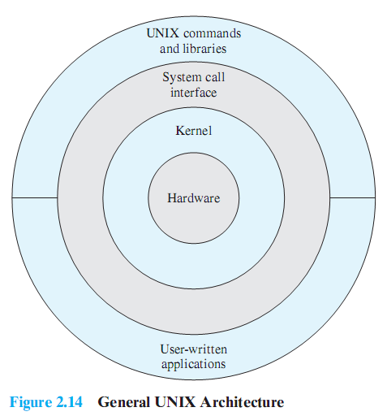
Description of UNIX
Notes:
Figure 2.16 provides a general description of the classic UNIX architecture. The
underlying hardware is surrounded by the OS software. The OS is often called the
system kernel, or simply the kernel, to emphasize its isolation from the user and applications.
It is the UNIX kernel that we will be concerned with in our use of UNIX as
an example in this book. UNIX also comes equipped with a number of user services
and interfaces that are considered part of the system. These can be grouped into
the shell, other interface software, and the components of the C compiler (compiler,
assembler, loader). The layer outside of this consists of user applications and the user
interface to the C compiler.

Slide 72
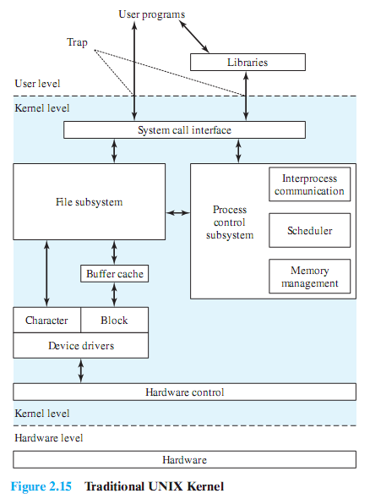
Traditional UNIX Kernel
Notes:
A closer look at the kernel is provided in Figure 2.17 . User programs can
invoke OS services either directly or through library programs. The system call
interface is the boundary with the user and allows higher-level software to gain
access to specific kernel functions. At the other end, the OS contains primitive routines
that interact directly with the hardware. Between these two interfaces, the
system is divided into two main parts, one concerned with process control and the
other concerned with file management and I/O. The process control subsystem is
responsible for memory management, the scheduling and dispatching of processes,
and the synchronization and interprocess communication of processes. The file system
exchanges data between memory and external devices either as a stream of
characters or in blocks. To achieve this, a variety of device drivers are used. For
block-oriented transfers, a disk cache approach is used: A system buffer in main
memory is interposed between the user address space and the external device.

Slide 73
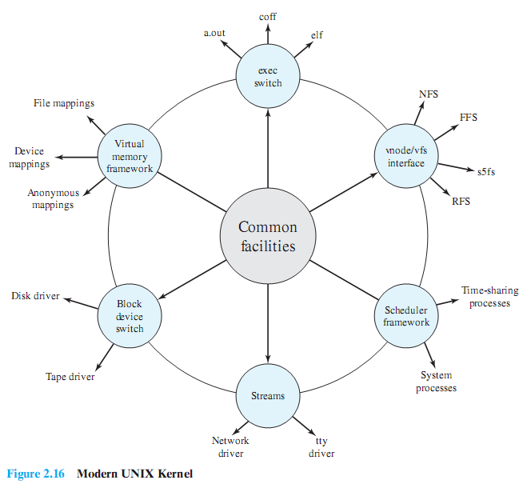
Modern UNIX Kernel
Notes:
As UNIX evolved, the number of different implementations proliferated, each providing
some useful features. There was a need to produce a new implementation that
unified many of the important innovations, added other modern OS design features,
and produced a more modular architecture. Typical of the modern UNIX kernel is
the architecture depicted in Figure 2.18 . There is a small core of facilities, written in
a modular fashion, that provide functions and services needed by a number of OS
processes. Each of the outer circles represents functions and an interface that may
be implemented in a variety of ways.

Slide 74
LINUX Overview
Started out as a UNIX variant for the IBM PC
Linus Torvalds, a Finnish student of computer science, wrote the initial version
Linux was first posted on the Internet in 1991
Today it is a full-featured UNIX system that runs on several platforms
Is free and the source code is available
Key to success has been the availability of free software packages
Highly modular and easily configured
Notes:
Linux started out as a UNIX variant for the IBM PC (Intel 80386) architecture.
Linus Torvalds, a Finnish student of computer science, wrote the initial version.
Torvalds posted an early version of Linux on the Internet in 1991. Since then, a
number of people, collaborating over the Internet, have contributed to the development
of Linux, all under the control of Torvalds. Because Linux is free and the
source code is available, it became an early alternative to other UNIX workstations,
such as those offered by Sun Microsystems and IBM. Today, Linux is a full-featured
UNIX system that runs on all of these platforms and more, including Intel Pentium
and Itanium, and the Motorola/IBM PowerPC.
Key to the success of Linux has been the availability of free software packages
under the auspices of the Free Software Foundation (FSF). FSF’s goal is stable,
platform-independent software that is free, high quality, and embraced by the user
community. FSF’s GNU project 3 provides tools for software developers, and the
GNU Public License (GPL) is the FSF seal of approval. Torvalds used GNU tools
in developing his kernel, which he then released under the GPL. Thus, the Linux
distributions that you see today are the product of FSF’s GNU project, Torvald’s
individual effort, and the efforts of many collaborators all over the world.
In addition to its use by many individual programmers, Linux has now made
significant penetration into the corporate world. This is not only because of the
free software, but also because of the quality of the Linux kernel. Many talented
programmers have contributed to the current version, resulting in a technically
impressive product. Moreover, Linux is highly modular and easily configured. This
makes it easy to squeeze optimal performance from a variety of hardware platforms.
Plus, with the source code available, vendors can tweak applications and utilities to
meet specific requirements. Throughout this book, we will provide details of Linux
kernel internals based on the most recent version, Linux 2.6.

Slide 75
Modular Monolithic Kernel
Includes virtually all of the OS functionality in one large block of code that runs as a single process with a single address space
All the functional components of the kernel have access to all of its internal data structures and routines
Linux is structured as a collection of modules
Loadable Modules
Relatively independent blocks
A module is an object file whose code can be linked to and unlinked from the kernel at runtime
A module is executed in kernel mode on behalf of the current process
Have two important characteristics:
Dynamic linking
Stackable modules
Notes:
Although Linux does not use a microkernel approach, it achieves many of the potential advantages of this approach by means of its particular modular architecture.
Linux is structured as a collection of modules, a number of which can be automatically loaded and unloaded on demand.
These relatively independent blocks are referred to as loadable modules.
In essence, a module is an object file whose code can be linked to and unlinked from the kernel at runtime.
The Linux loadable modules have two important characteristics:
Dynamic linking: A kernel module can be loaded and linked into the kernel while the kernel is already in memory and executing.
A module can also be unlinked and removed from memory at any time.
Saves kernel memory.
Stackable modules: The modules are arranged in a hierarchy.
Individual modules serve as libraries when they are referenced by client modules higher up in the hierarchy, and as clients when they reference modules further down.

Slide 76
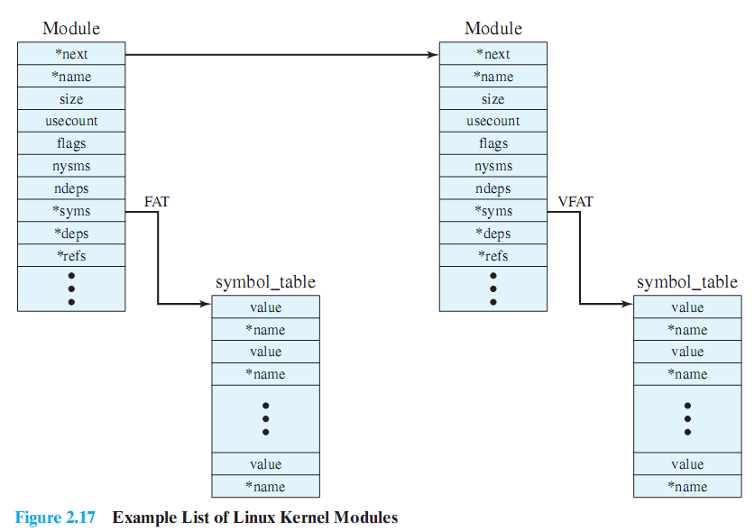
Linux Kernel Modules
Notes:
Figure 2.19 is an example that illustrates the structures used by Linux to
manage modules. The figure shows the list of kernel modules after only two modules
have been loaded: FAT and VFAT. Each module is defined by two tables, the module
table and the symbol table. The module table includes the following elements:
• * next: Pointer to the following module. All modules are organized into a
linked list. The list begins with a pseudomodule (not shown in Figure 2.19 ).
• * name: Pointer to module name
• size: Module size in memory pages
• usecount: Module usage counter. The counter is incremented when an operation
involving the module’s functions is started and decremented when the
operation terminates.
flags: Module flags
• nsyms: Number of exported symbols
• ndeps: Number of referenced modules
• * syms: Pointer to this module’s symbol table.
• * deps: Pointer to list of modules that are referenced by this module.
• * refs: Pointer to list of modules that use this module.
The symbol table defines those symbols controlled by this module that are
used elsewhere.
Figure 2.19 shows that the VFAT module was loaded after the FAT module
and that the VFAT module is dependent on the FAT module.

Slide 77
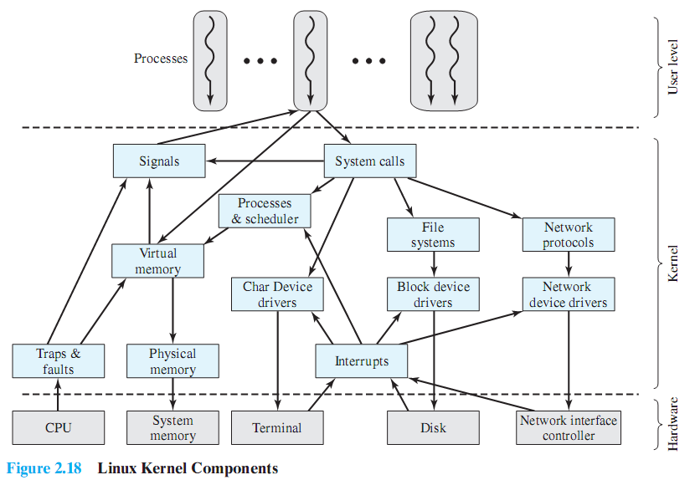
Linux Kernel Components
Notes:
Figure 2.20 , taken from [MOSB02], shows the main components of the Linux kernel
as implemented on an IA-64 architecture (e.g., Intel Itanium). The figure shows
several processes running on top of the kernel. Each box indicates a separate process,
while each squiggly line with an arrowhead represents a thread of execution. 4
The kernel itself consists of an interacting collection of components, with arrows
indicating the main interactions. The underlying hardware is also depicted as a
set of components with arrows indicating which kernel components use or control
which hardware components. All of the kernel components, of course, execute on
the processor but, for simplicity, these relationships are not shown.

Slide 78
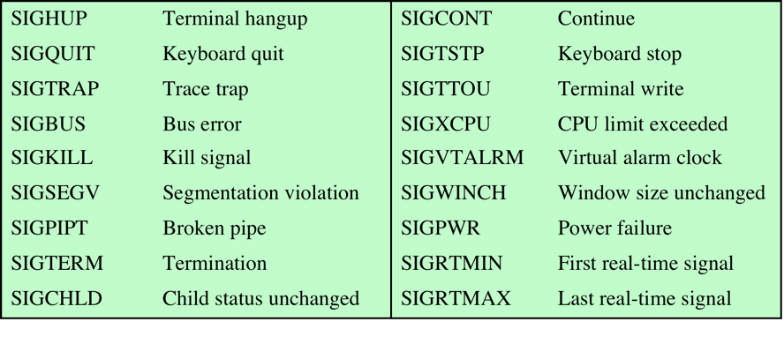
Linux Signals
Table 2.5 Some Linux Signals
Notes:
The kernel uses signals to call into a process. For example, signals are
used to notify a process of certain faults, such as division by zero. Table 2.5
gives a few examples of signals.

Slide 79
Linux Vserver Virtual Machine Architecture
Open-source, fast, lightweight approach to implementing virtual machines on a Linux server
Only a single copy of the Linux kernel is involved
Supports a number of separate virtual servers
Each virtual server is isolated from the others
Involves four elements:
chroot – UNIX or Linux command to make the root directory become something other than its default
chcontext – allocates a new security context
chbind – executes a command and locks the resulting process and its children into using a specific IP address
capabilities – a partitioning of the privileges available to a root user
Notes:
Linux VServer is an open-source, fast, lightweight approach to implementing
virtual machines on a Linux server [SOLT07, LIGN05]. Only a single copy
of the Linux kernel is involved. VServer consists of a relatively modest modification
to the kernel plus a small set of OS userland 5 tools. The VServer Linux
kernel supports a number of separate virtual servers. The kernel manages all system
resources and tasks, including process scheduling, memory, disk space, and
processor time. This is closer in concept to the process VM rather than the system
VM of Figure 2.14 .
Each virtual server is isolated from the others using Linux kernel capabilities.
This provides security and makes it easy to set up multiple virtual machines on a
single platform. The isolation involves four elements: chroot, chcontext, chbind, and
capabilities.
The chroot command is a UNIX or Linux command to make the root directory
(/) become something other than its default for the lifetime of the current process.
It can only be run by privileged users and is used to give a process (commonly a network
server such as FTP or HTTP) access to a restricted portion of the file system.
This command provides file system isolation . All commands executed by the virtual
server can only affect files that start with the defined root for that server.
The chcontext Linux utility allocates a new security context and executes
commands in that context. The usual or hosted security context is the context 0.
This context has the same privileges as the root user (UID 0): This context can
see and kill other tasks in the other contexts. Context number 1 is used to view
other contexts but cannot affect them. All other contexts provide complete isolation:
Processes from one context can neither see nor interact with processes from
another context. This provides the ability to run similar contexts on the same computer
without any interaction possible at the application level. Thus, each virtual
server has its own execution context that provides process isolation .
The chbind utility executes a command, and locks the resulting process and
its children into using a specific IP address. Once called, all packets sent out by this
virtual server through the system’s network interface are assigned the sending IP
address derived from the argument given to chbind. This system call provides network
isolation : Each virtual server uses a separate and distinct IP address. Incoming
traffic intended for one virtual server cannot be accessed by other virtual servers.
Finally, each virtual server is assigned a set of capabilities . The concept of
capabilities, as used in Linux, refers to a partitioning of the privileges available to
a root user, such as the ability to read files or to trace processes owned by another
user. Thus, each virtual server can be assigned a limited subset of the root user’s
privileges. This provides root isolation . VServer can also set resource limits, such as
limits to the amount of virtual memory a process may use.

Slide 80
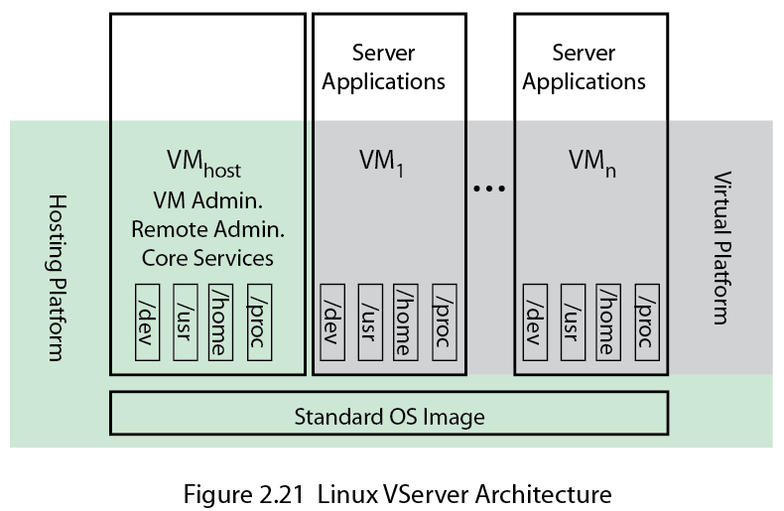
Linux Vserver Architecture
Notes:
Figure 2.21 , based on [SOLT07], shows the general architecture of Linux
VServer. VServer provides a shared, virtualized OS image, consisting of a root file
system, and a shared set of system libraries and kernel services. Each VM can be
booted, shut down, and rebooted independently. Figure 2.21 shows three groupings
of software running on the computer system. The hosting platform includes the
shared OS image and a privileged host VM, whose function is to monitor and manage
the other VMs. The virtual platform creates virtual machines and is the view of
the system seen by the applications running on the individual VMs.

Slide 81
Summary
Operating system objectives and functions:
convenience, efficiency, ability to evolve
user/computer interface
resource manager
Evolution:
serial processing, simple batch systems, multiprogrammed batch systems, time sharing systems
Microsoft Windows/Windows 7
UNIX/Linux systems
Process
Memory management
real address, virtual address
Scheduling and resource management
Multithreading
Symmetric multiprocessing (SMP)
distributed OS
object oriented design
Virtual machines
virtualization
Notes:
Summary of Chapter 2.

